Slide 1
Cedar Lake Police Department 2024 Year in Review & 5 Year Report

Slide 2
2024 Year in review HIGHLIGHTS

Slide 3
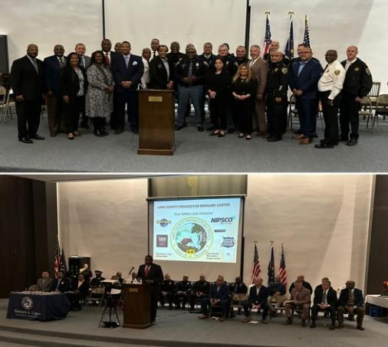
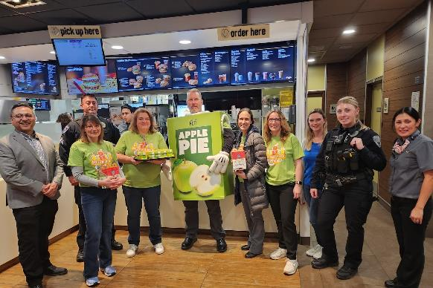
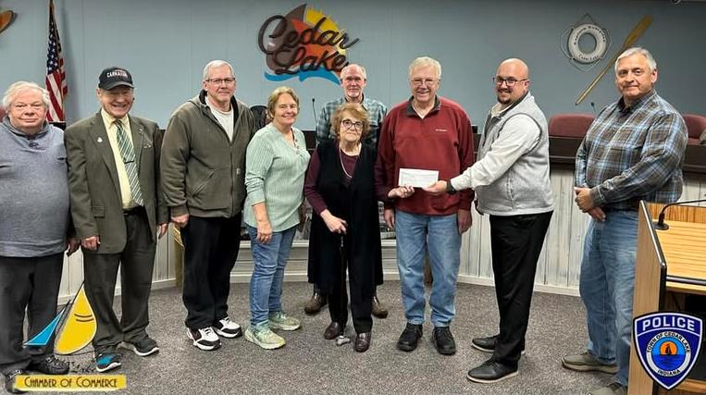
January 2024
01.17.24 Fair Haven Human Trafficking Awareness Event
01.24.24 Chamber of Commerce Equipment Donation
01.26.24 Lake County Prosecutor Bernard Carter Gunlock Safety Event
01.30.24 Mc Teacher Night

Slide 4
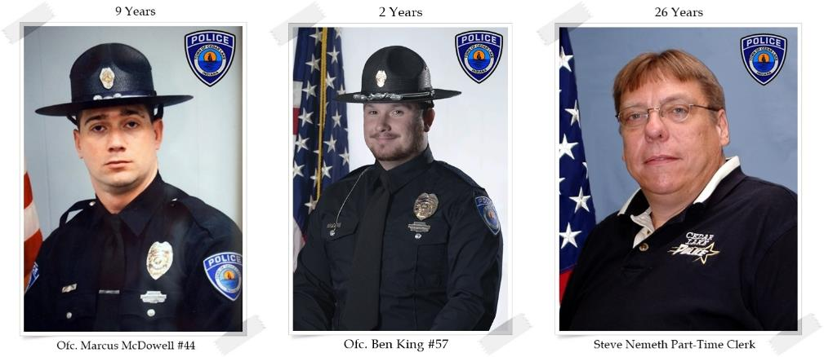
January 2024
EMPLOYEE ANNIVERSARIES
Officer Marcus McDowell #44 – 9 Years
Officer Ben King #57 – 2 Years
Part-Time Clerk Steve Nemeth – 26 Years

Slide 5
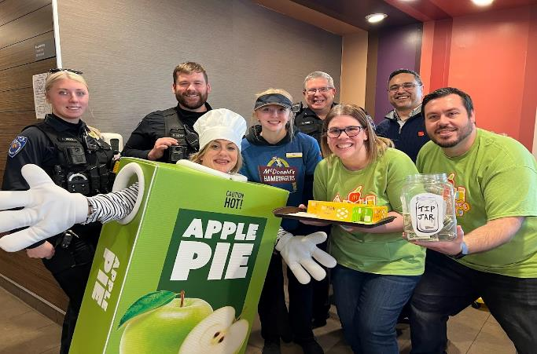
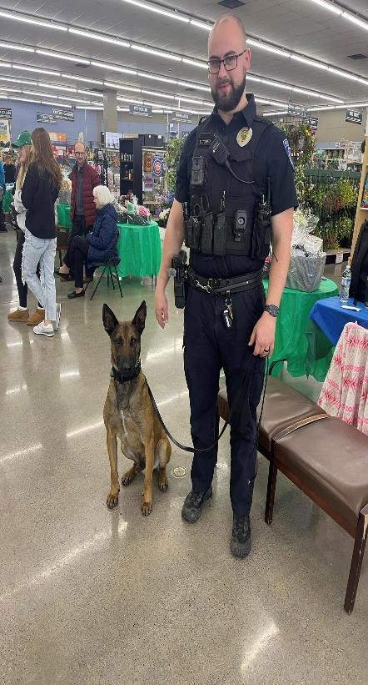
February 2024
02.13.24 Mc Teacher Night
02.15.24 SRO Recognition
02.24.24 Alsip Nursery Event with K9 Johnny
Resignation of VIPS Bill Horn & Patrolman Nick Enyeart

Slide 6
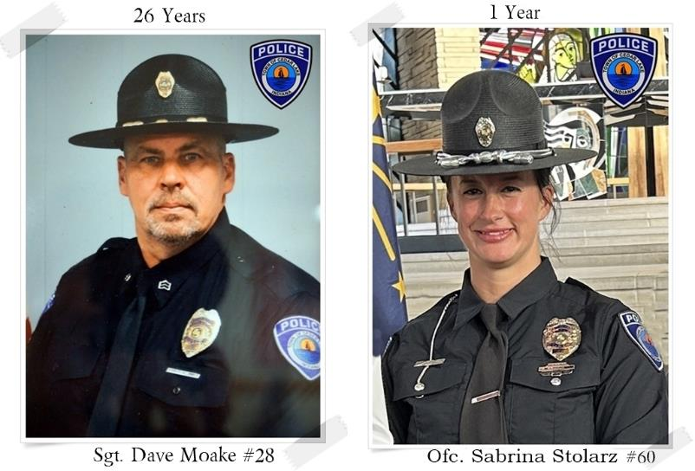
FEBRUARY 2024
EMPLOYEE ANNIVERSARIES
Sergeant Dave Moake #28 – 26 Years
Officer Sabrina Stolarz #60 – 1 Year

Slide 7
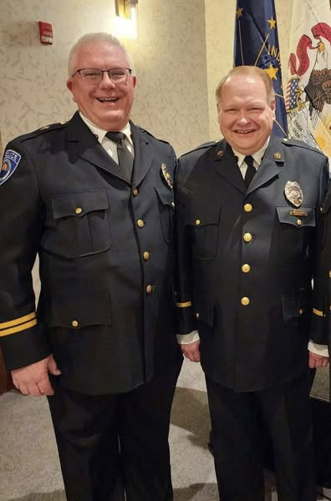
march 2024
03.05.24 Region 4 International Conference of Police Chaplains
03.05.24 Approval from Town Council to purchase 4 new vehicles
March & April – Department-wide EAP Training on Sensitivity & Ethics

Slide 8
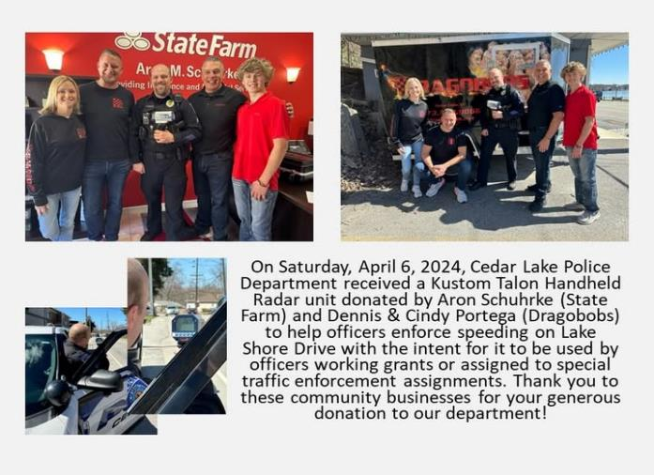
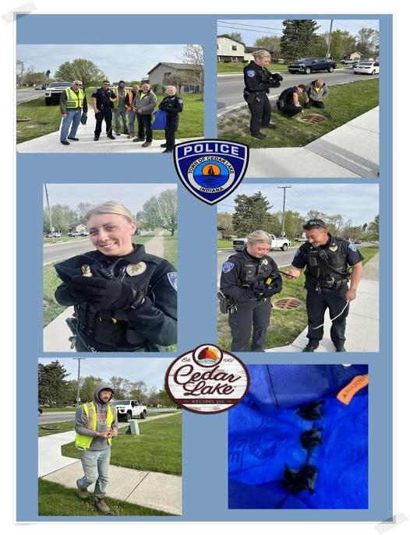
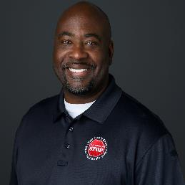
april 2024
04.06.24 Schurhrke & Portega Donations for Radar Equipment
04.25.24 Tall Cop Training (4 Admin Staff attended)
04.26.24 Saving Ducklings
DEA National Drug Take Back Event

Slide 9
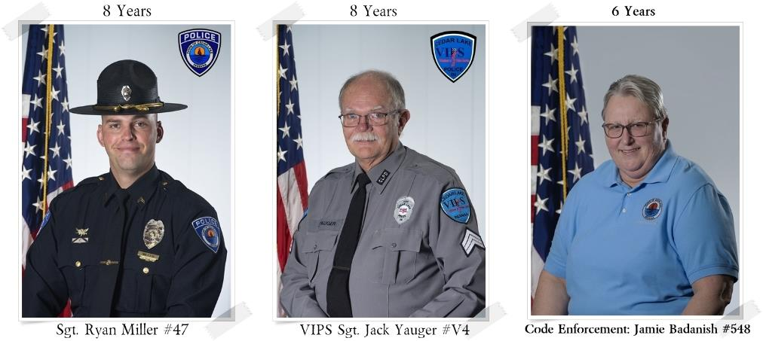
APRIL 2024
EMPLOYEE ANNIVERSARIES
Sergeant Ryan Miller #47 – 8 Years
VIPS Sgt. Jack Yauger #V$ - 8 Years
Code Enforcement Jamie Badanish #548 – 6 Years

Slide 10
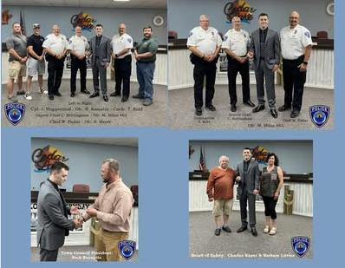
may 2024
Police Week
Farmers Market detail May - October
05.15.24 Red Cedars Graduation of Too Good For Drugs Program
05.21.24 Patrolman Milan #62 Sworn In
05.31.24 District 1 Annual Ceremony – Lifesaving Award to Patrolman Kamstra
Dept-wide Training: Vehicle Pursuits, Use of Force & UKG Timekeeping System

Slide 11
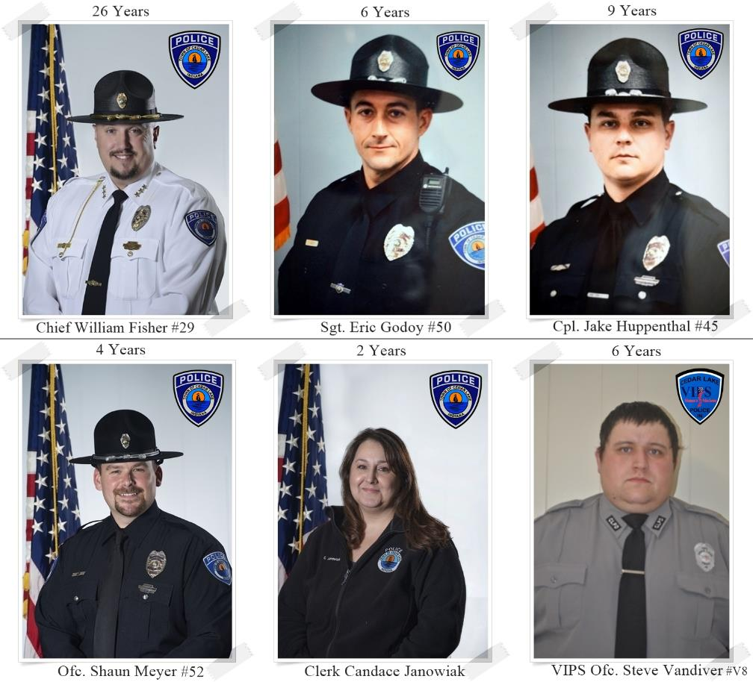
mAY 2024
EMPLOYEE ANNIVERSARIES
Chief William Fisher #29 – 26 Years
Sergeant Eric Godoy #50 – 6 Years
Corporal Jake Huppenthal #45 – 9 Years
Officer Shaun Meyer #52 – 4 years
Clerk Candace Janowiak – 2 Years
VIPS Officer Steve Vandiver #V8 – 6 Years

Slide 12
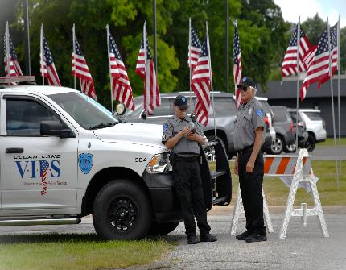
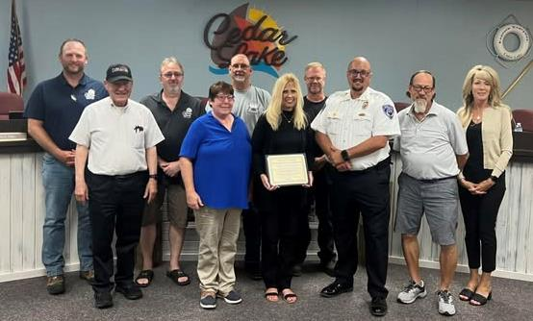
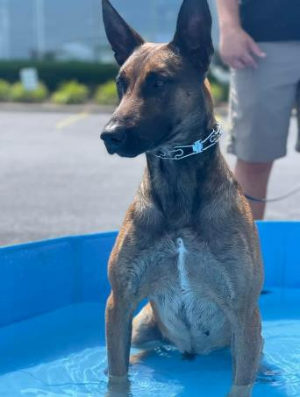
june 2024
06.08.24 Focus Vibe – K9 Community Engagement Event/ Pawty
Donations:
Sounds of Sarah – Opioid Rescue Box & Naloxone
CL Fraternal Order of Eagles
SAFE Grant Received
06.23.24 Protecting K9 Heroes Open House

Slide 13
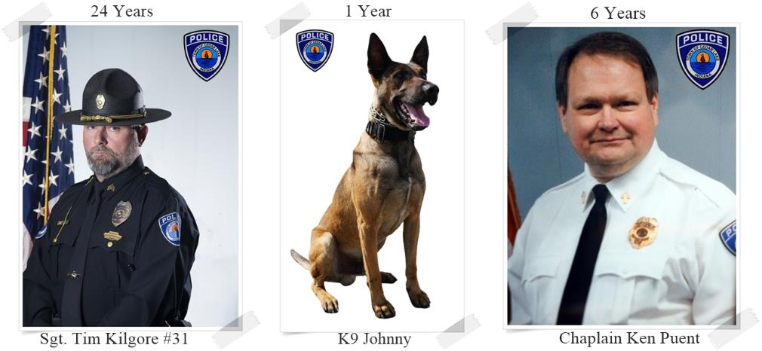
JUNE 2024
EMPLOYEE ANNIVERSARIES
Sergeant Tim Kilgore #31 – 24 Years
K9 Johnny – 1 Year
Chaplain Ken Puent – 6 Years

Slide 14
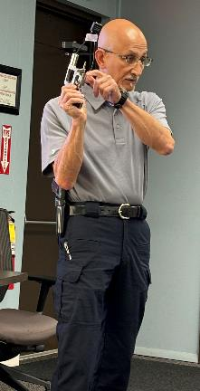
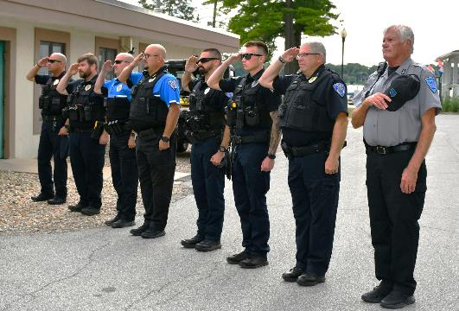
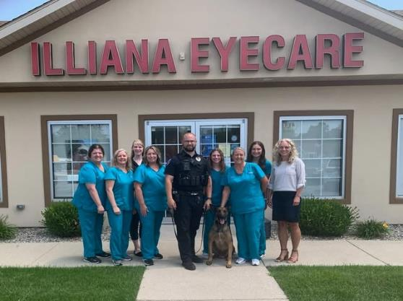
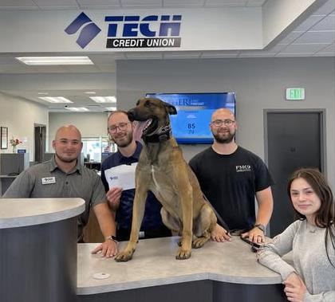
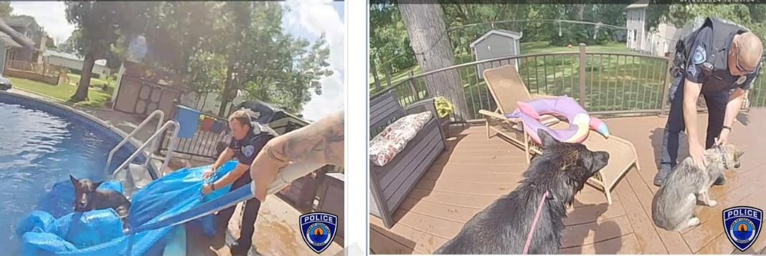
july 2024
SUMMERFEST & Parades
K9 Donation/Community Events - Tech Credit & Illiana Eye Care
Dogs Rescued from Local Pool
Resignation of Patrolman Bradley Kamstra
07.20.24 Firearm Community Safety Class
Funding: NIPSCO grant & Project Child Safe Lock Donation

Slide 15
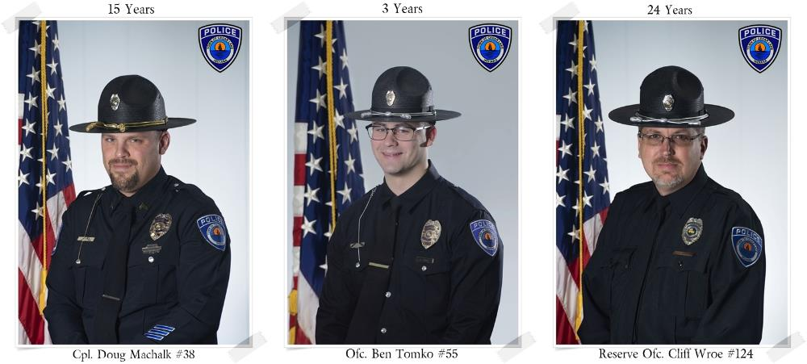
JULY 2024
EMPLOYEE ANNIVERSARIES
Corporal Doug Machalk #38 – 15 Years
K9 Officer Ben King #55 – 3 Years
Reserve Officer Cliff Wroe #124 – 24 Years

Slide 16
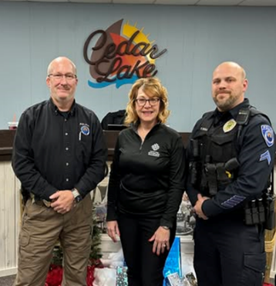
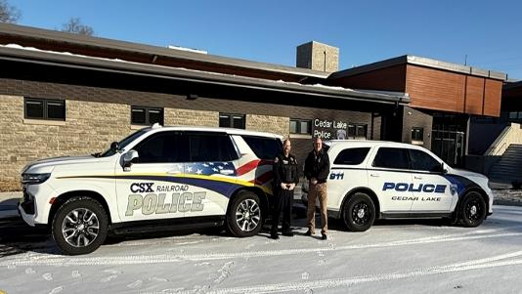
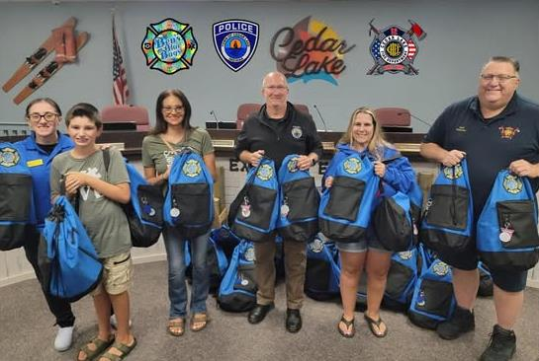
august 2024
08.20.24 Logans Love & Bens Blue Bag Donations (Autism Training)
08.28.24 VIPS Member Michael Patierno Appointed
Crown Point Community Foundation & CSX Railroad Grant Obtained to Purchase Gas Masks; Training also provided by CSX for Railway Safety
Obtained Free Steering Wheel Locks from Hyundai for Anti-Theft Community Campaign

Slide 17
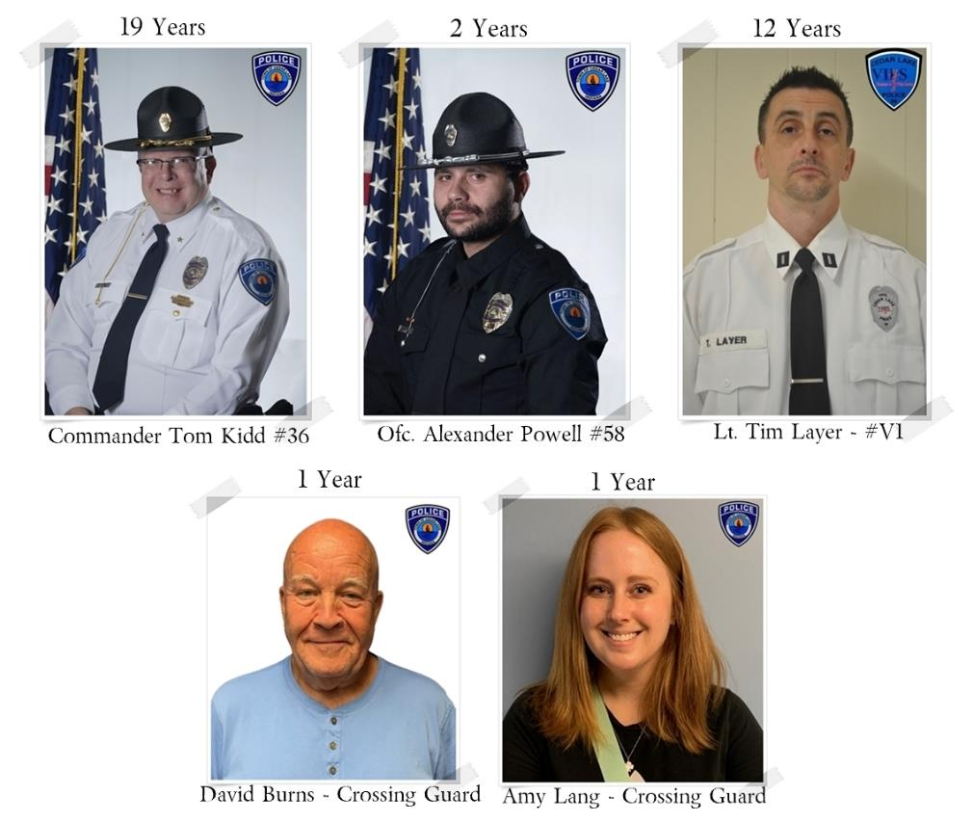
aUGUST 2024
EMPLOYEE ANNIVERSARIES
Commander Tom Kidd #36 – 19 Years
Officer Alexander Powell #58 – 2 Years
VIPS Lt. Tim Layer #V1 – 12 Years
Crossing Guard David Burns – 1 Year
Crossing Guard Amy Lang – 1 Year

Slide 18
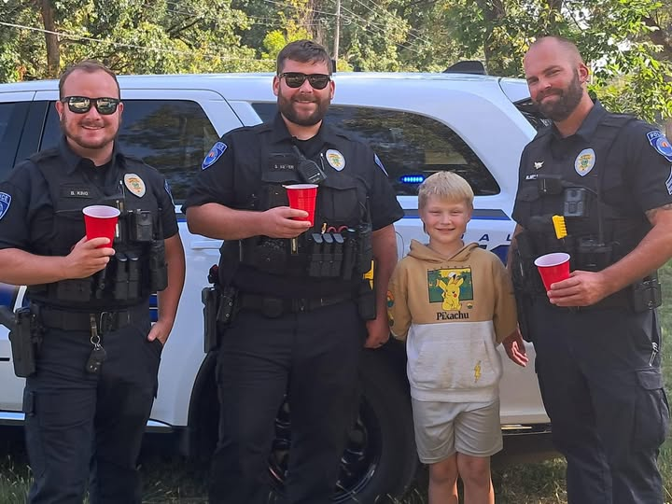
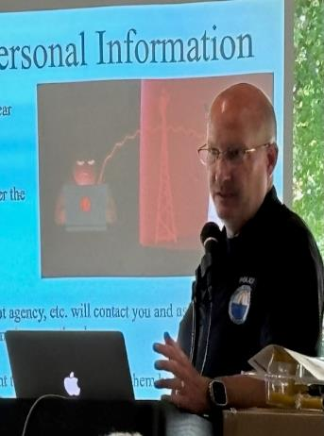
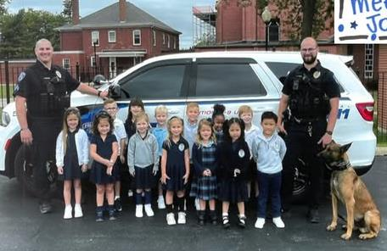
september 2024
09.09.24 Parks Dept Senior Social – Detective Brittingham discussed Safety/Fraud
Community Education & Engagement – handed out free gun locks, car steering wheel locks DeTerra medication disposal bags and literature
09.18.24 Lemonade Stand visit – proceeds to benefit 2 dog rescues
09.26.24 Officer Tomko, K9 Johnny and Corporal Huppenthal visited St. Mary’s School to talk about police officers, the department & Johnny’s role

Slide 19
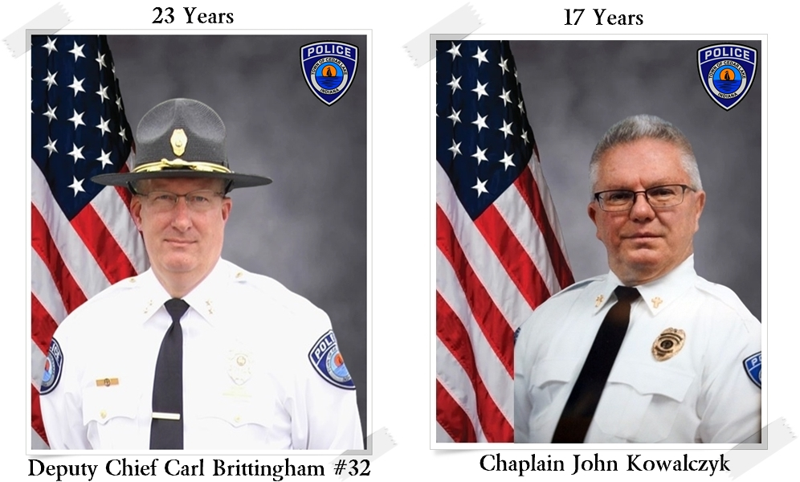
SEPTEMBER 2024
EMPLOYEE ANNIVERSARIES
Deputy Chief Carl Brittingham #32 – 23 Years
Chaplain John Kowalczyk – 17 Years

Slide 20
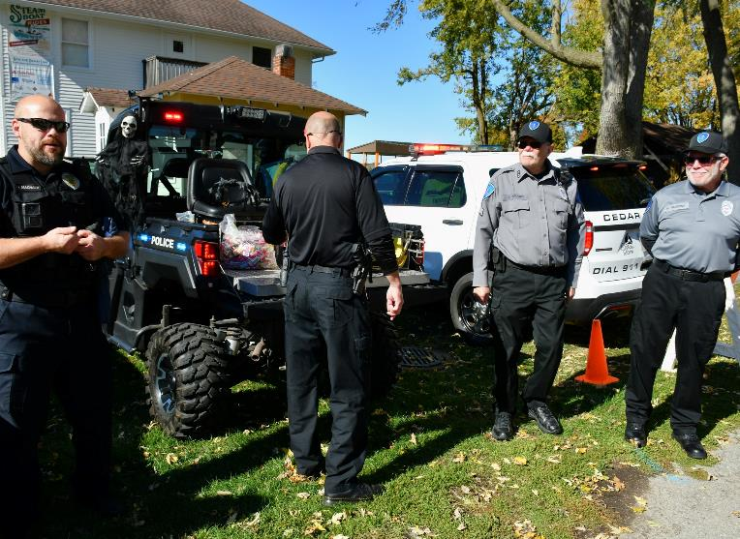
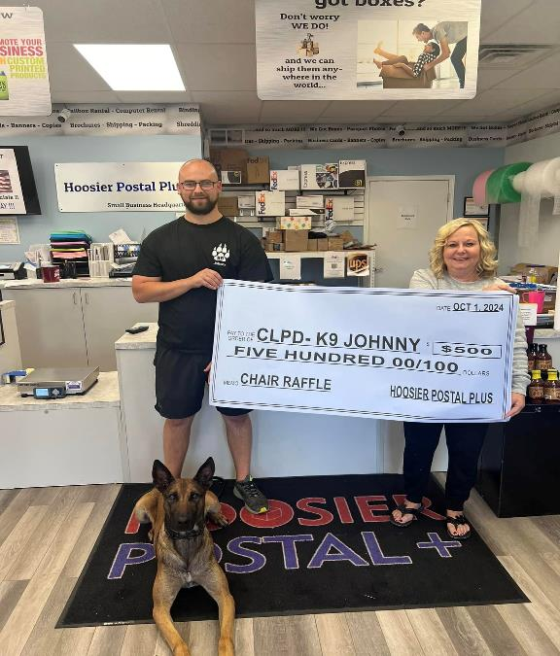
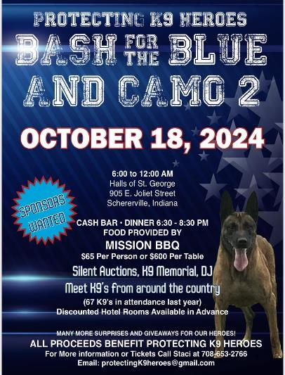
october 2024
DEA National Drug Take Back Event
10.01.24 Hoosier Postal Fundraising for K9
10.03 & 10.10 – Defensive Tactics Training
10.19.24 Protecting K9 Heroes Bash for the Blue and Camo 2
10.26.24 Trunk or Treat

Slide 21
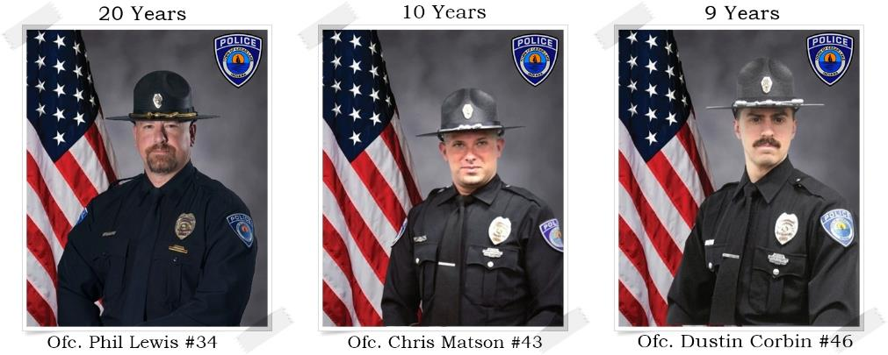
October 2024
EMPLOYEE ANNIVERSARIES
Officer Phil Lewis #34 – 20 Years
Officer Chris Matson #43 – 10 Years
Officer Dustin Corbin #46 – 9 Years

Slide 22
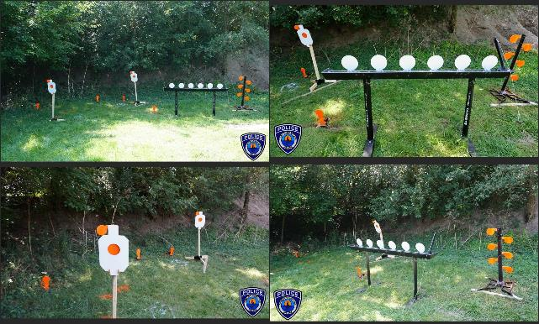
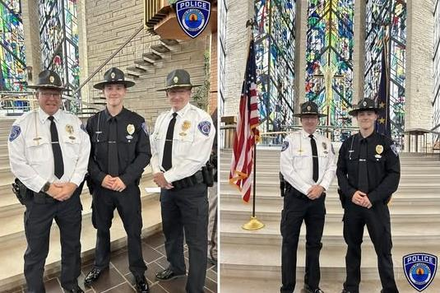
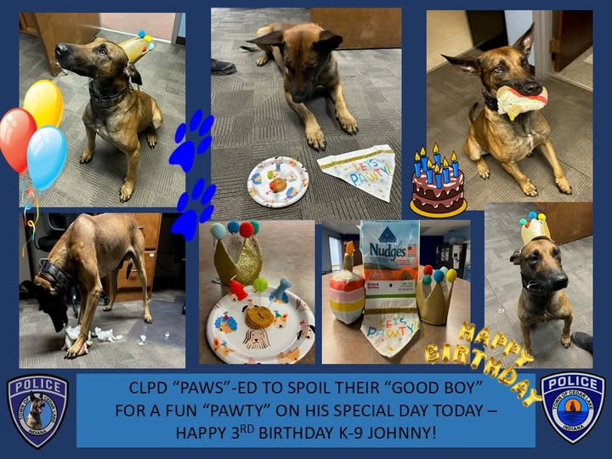
November 2024
Department Firearms Training - Equipment purchased from NIPSCO Grant
11.15.24 NILEA Graduation Ceremonies for Milan #62
11.08.24 Celebrating K9 Johnny’s Birthday

Slide 23
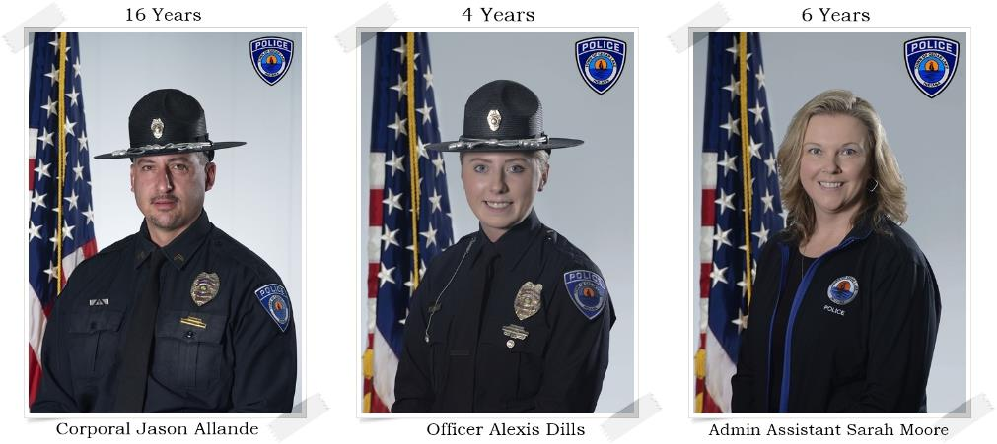
NOVEMBER 2024
EMPLOYEE ANNIVERSARIES
Corporal Jason Allande #37 – 16 Years
Officer Alexis Dills #53 – 4 Years
Administrative Assistant Sarah Moore – 6 Years

Slide 24
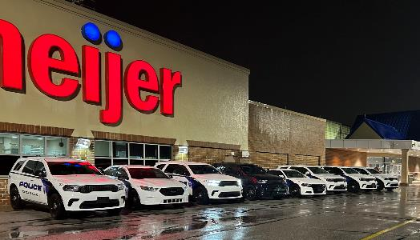
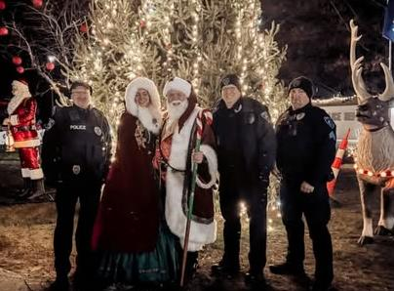
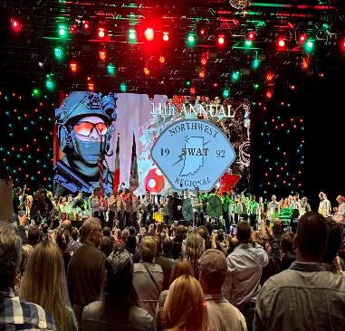
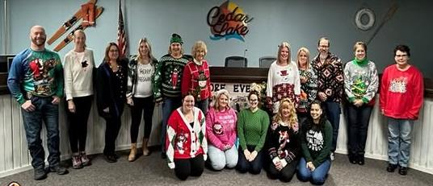
december 2024
Taylor Ice Festival
NWI Regional SWAT annual fundraiser
12.15.24 FOP Shop with a Cop
Town Hall & CLPD Ugly Sweater Contest
Department-Wide Annual Performance Evaluations Completed
Resignation of VIPS Steve VanDiver & Patrolman Phil Lewis

Slide 25
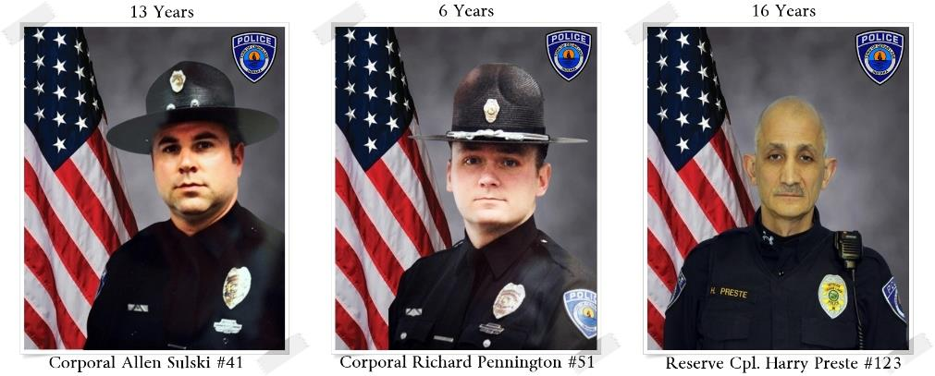
DECEMBER 2024
EMPLOYEE ANNIVERSARIES
Corporal Allen Sulski #41 – 13 Years
Corporal Richard Pennington #51 – 6 Years
Reserve Corporal Harry Preste #123 – 16 Years

Slide 26
5 YEAR REPORT COMPARISONS

Slide 27
CALLS FOR SERVICE INCIDENTS

Slide 28
5 YEAR INCIDENTS

Slide 29
TRAFFIC STOP ANALYSIS

Slide 30
5 YEAR TRAFFIC CITATIONS & WARNINGS

Slide 31
WARNING ANALYSIS

Slide 32
5 YEAR WARNING DEMOGRAPHICS

Slide 33
CITATIONS ANALYSIS

Slide 34
5 YEAR CITATION DEMOGRAPHICS

Slide 35
LAW INCIDENT ANALYSIS

Slide 36
ARREST ANALYSIS

Slide 37
ARREST OFFENSE ANALYSIS

Slide 38
5 YEAR ARRESTS

Slide 39
5 YEAR ARREST DEMOGRAPHICS

Slide 40
TOWN ORDINANCE WARNINGS

Slide 41
TOWN ORDINANCE WARNINGS

Slide 42
TOWN ORDINANCE WARNINGS

Slide 43
TOWN ORDINANCE CITATIONS

Slide 44
TOWN ORDINANCE CITATIONS

Slide 45
TOWN ORDINANCE CITATIONS

Slide 46
Donations/grants

Slide 47
Donations/grants

Slide 48
Donations/grants

Slide 49
Donations/grants

Slide 50
Cedar Lake Police Department
ADMINISTRATION:
Interim Chief of Police – Carl Brittingham
Patrol Commander – Thomas Kidd
Administrative Assistant – Sarah Moore

