Slide 1
Cedar Lake Police Department 2023 Year in Review & 5 Year Report

Slide 2
2023 Year in review

Slide 3
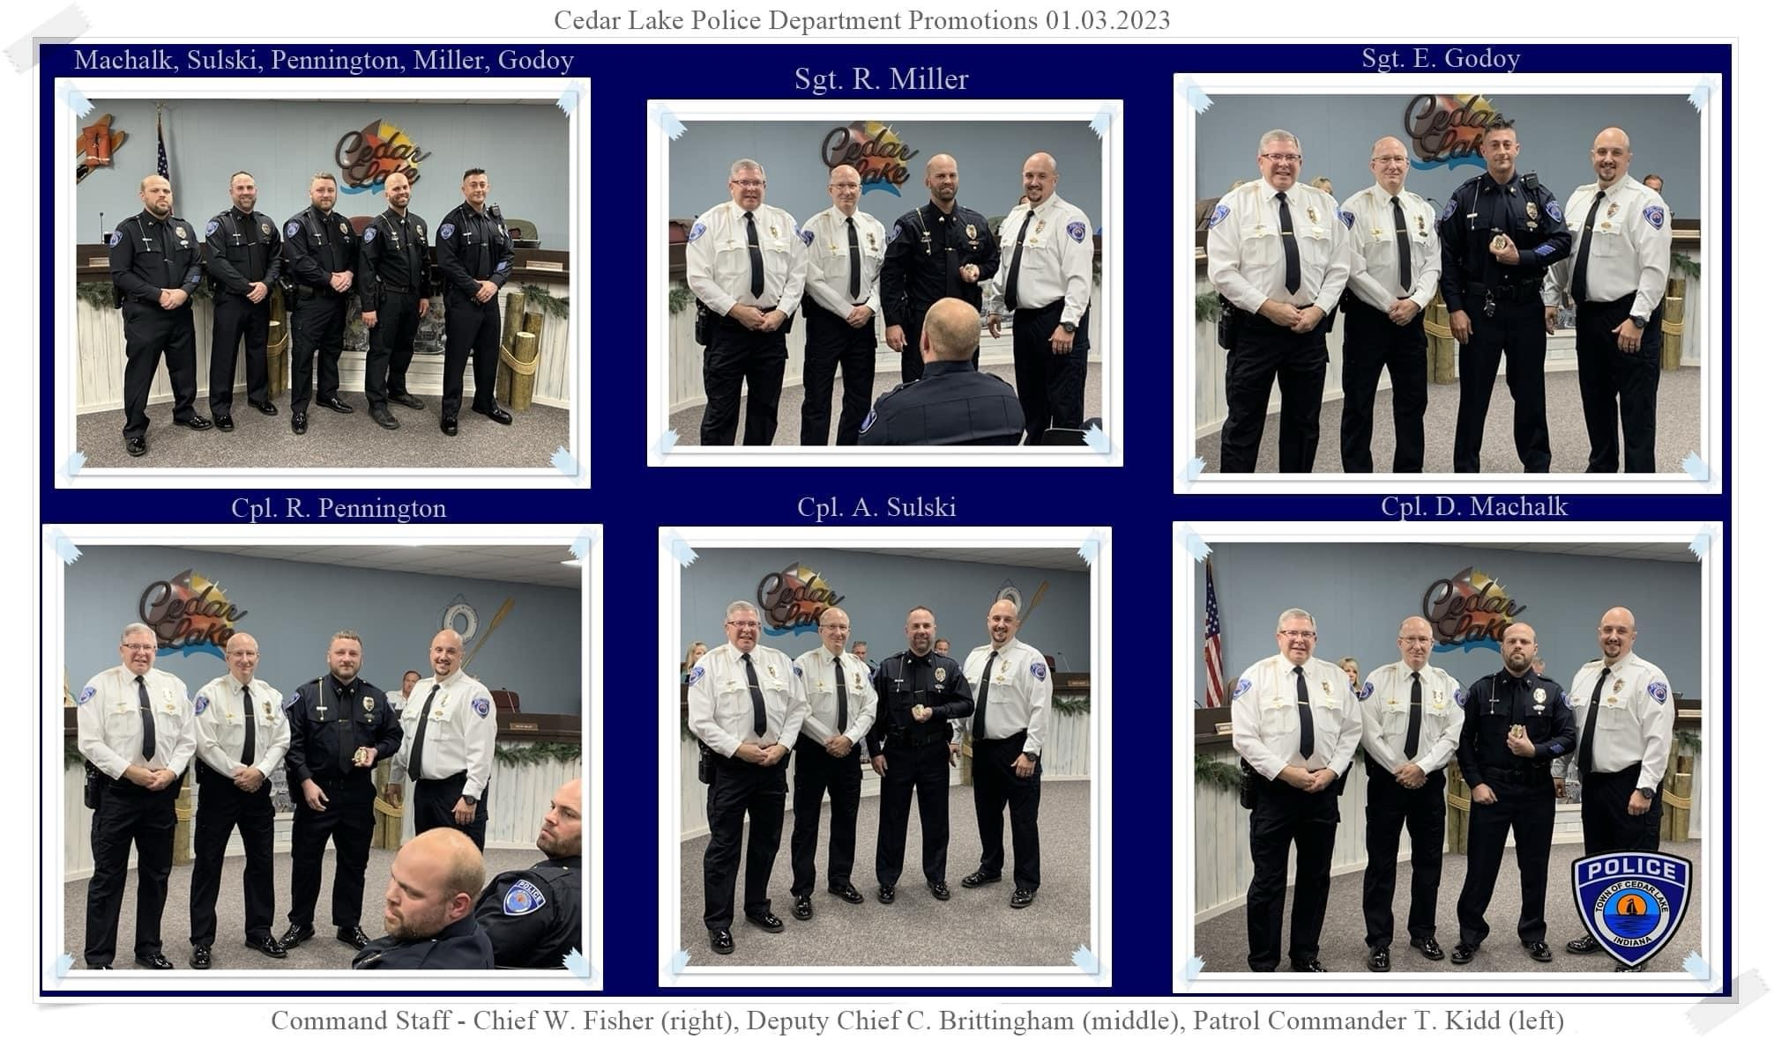
January 2023
12 hour shifts start
01.03.23 Officer Promotions Presented to Town Council:
Corporal Pennington
Corporal Sulski
Corporal Machalk
Sergeant Miller
Sergeant Godoy
Body & Car Cameras
Police Social Worker Internship/Mona Garcia
01.14.23 Principles & Concepts of Personal Safety community outreach education (Reserve Corporal Harry Preste)

Slide 4
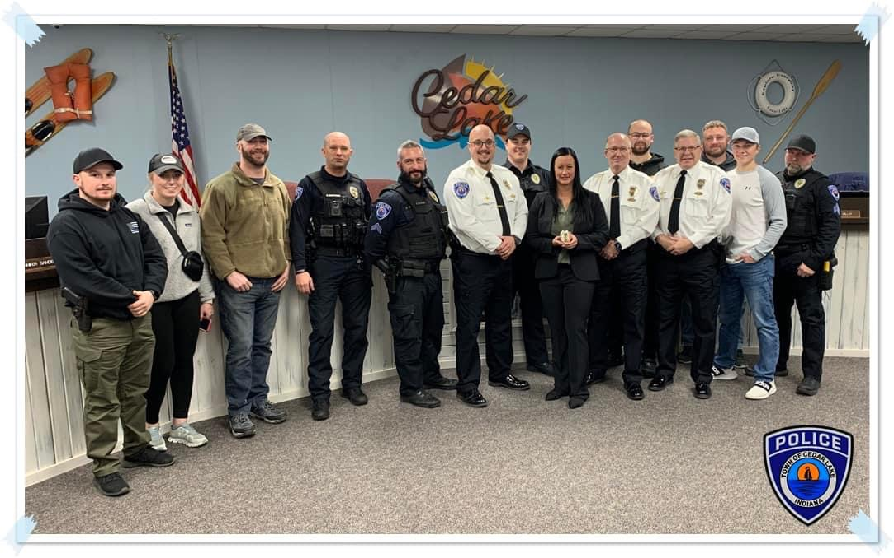
February 2023
02.21.23 Officer Sabrina Stolarz (#60) sworn in

Slide 5
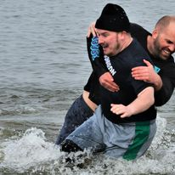
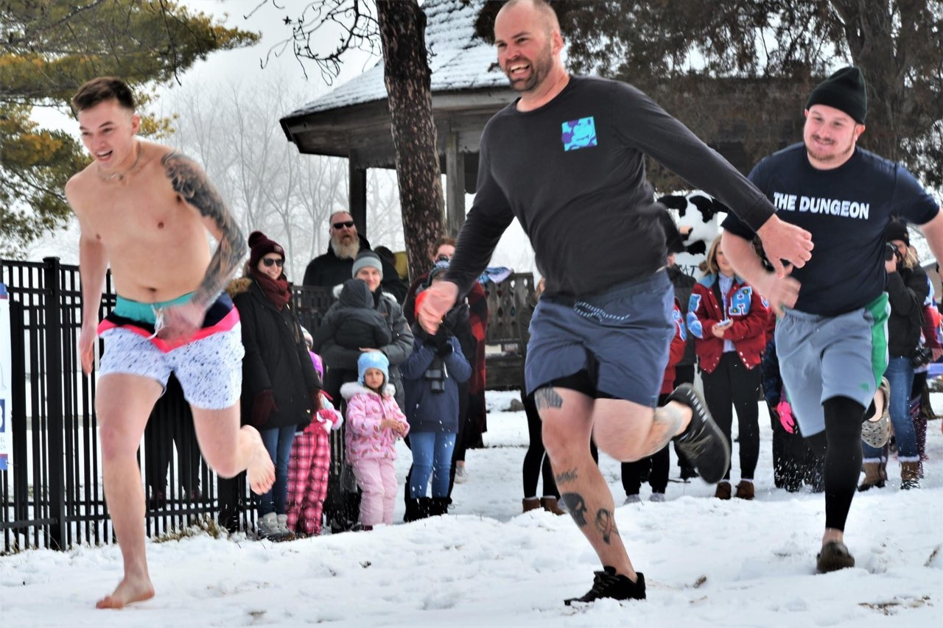
march 2023
03.04.23 Officer Kamstra, Officer King and Sergeant Miller participated in Penguin Plop
03.07.23 Donation Check presented to NWI NICK

Slide 6
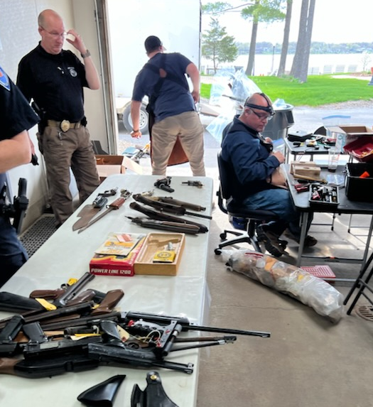
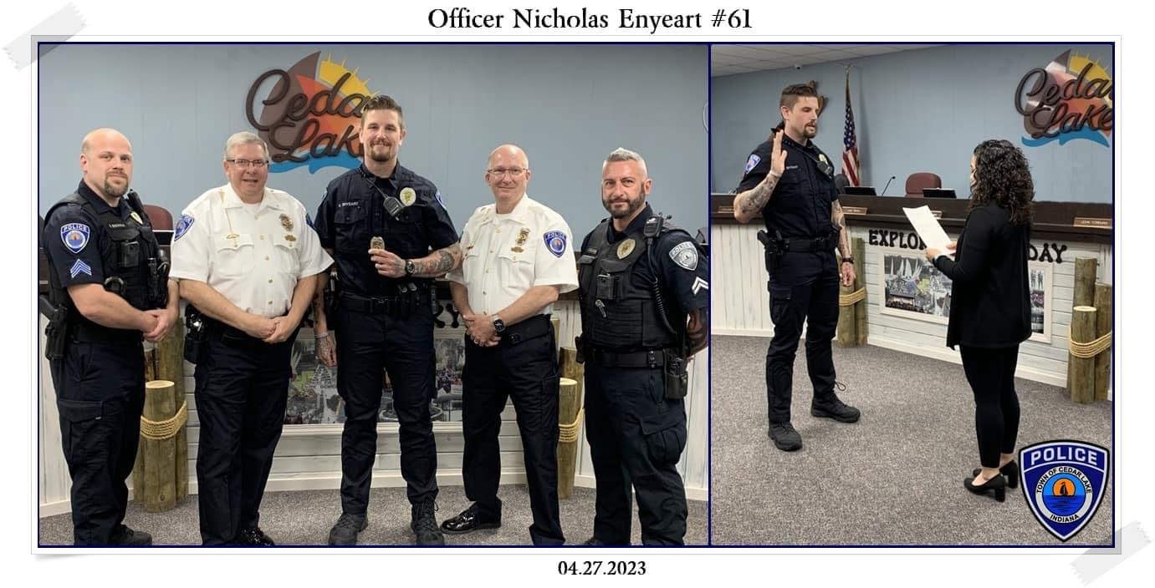
april 2023
04.14.23 Building Ground Breaking
04.27.23 Officer Nicholas Enyeart (#61) sworn in
Drug Take Back Day
Wellness Program, Employee Assistance Program, & Peer Support Specialist all approved
Emergency Operations Plan Completed
04.19.23 Firearms Destruction

Slide 7
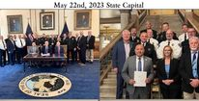
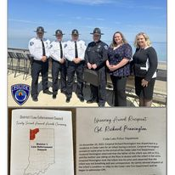
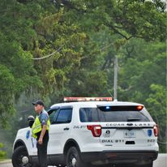
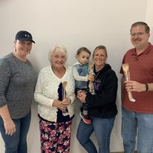
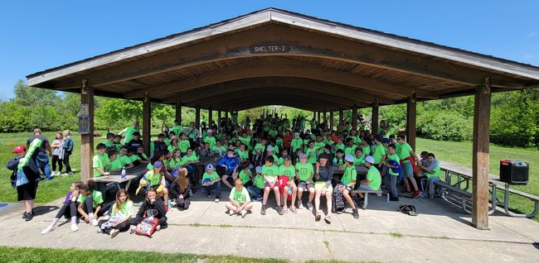
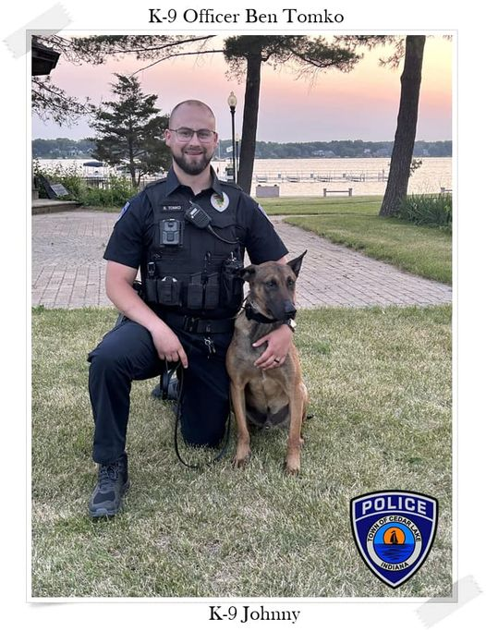
may 2023
05.20.23 PD & FD Chili Cookoff/Fundraiser for Social Worker Intern Mona Garcia
05.22.23 State Capitol – Stop the Bleed
MacArthur & Red Cedars DARE Graduations
K9 Johnny received & start of training
05.29.23 Memorial Day Parade/Festivities
05.30.23 District 1 Law Enforcement Awards Ceremony: Recognition to Corporal Pennington (#51)

Slide 8
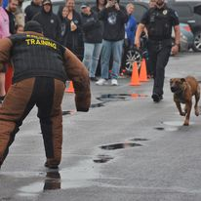
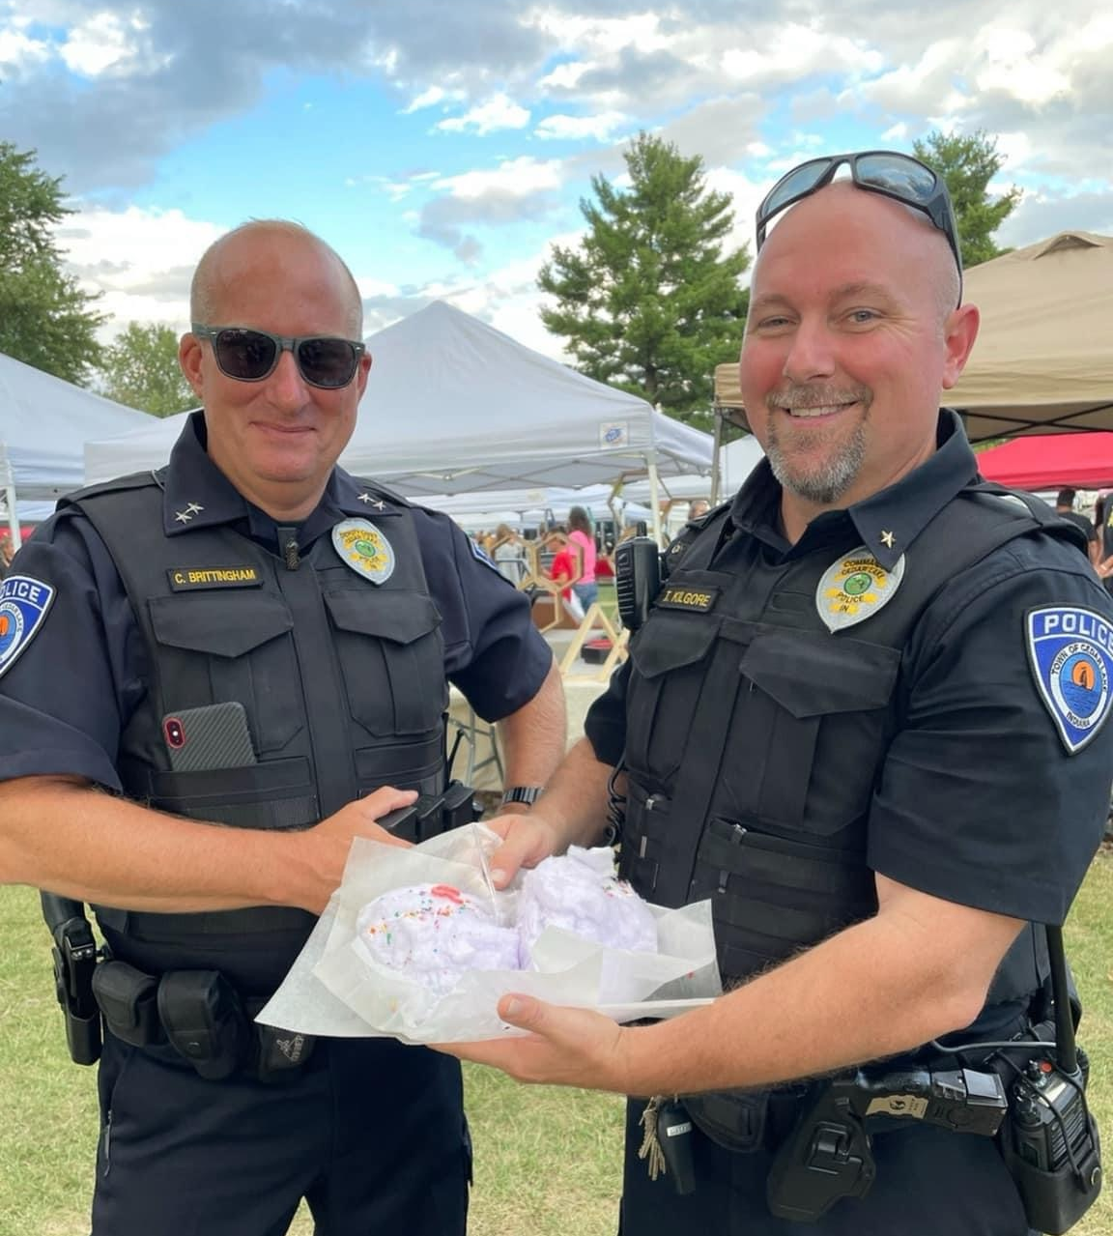
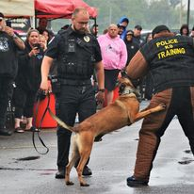
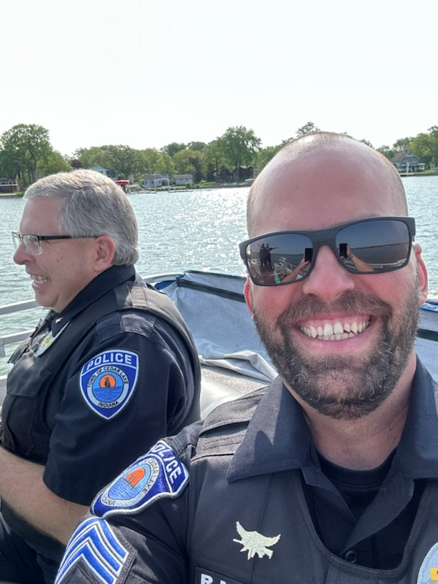
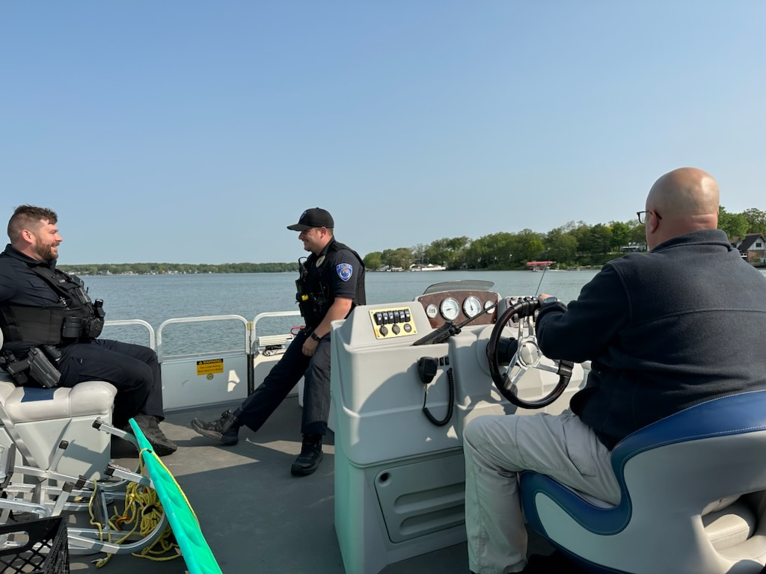
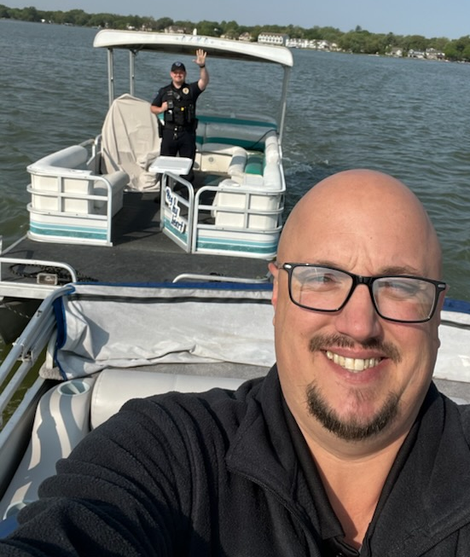
june 2023
Lake Patrol: many encounters, trainings and interactions throughout the year
Mid-May through October – Cedar Lake Farmers Market
06.11.23 Provided VIPS, SWAT and K9 support along with staff volunteers for Protecting K9 Heroes 6th Anniversary & Open House

Slide 9
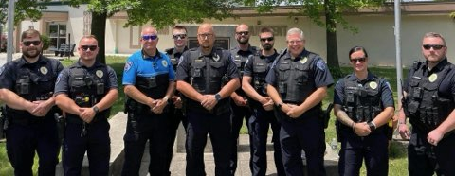
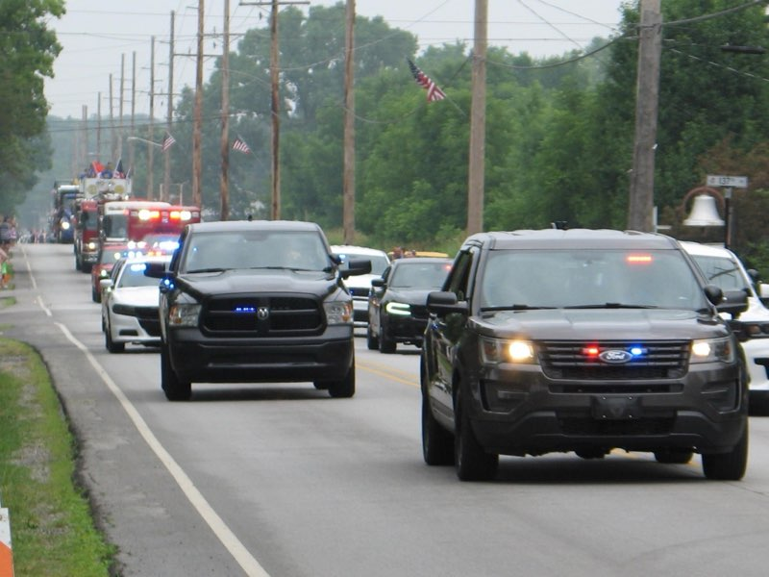
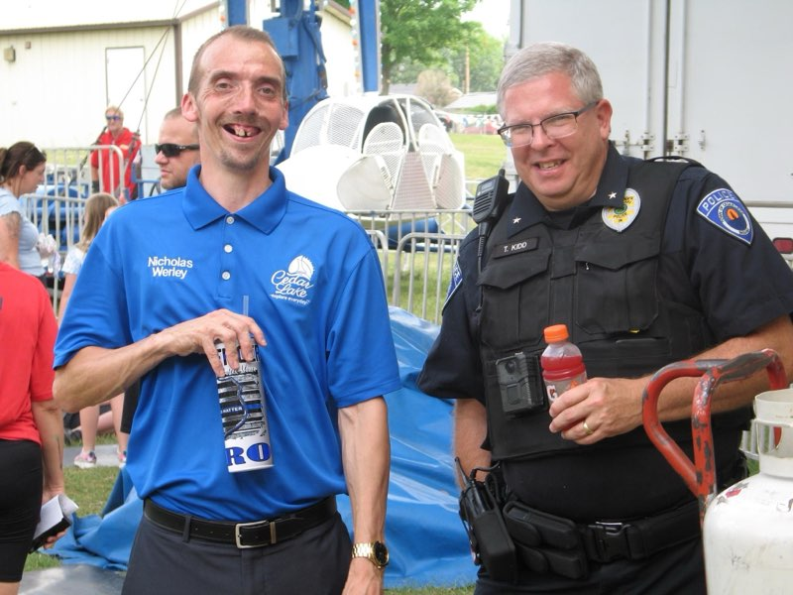
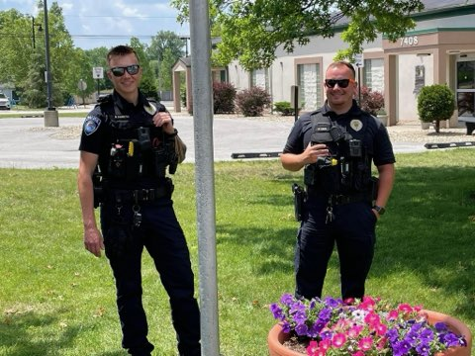
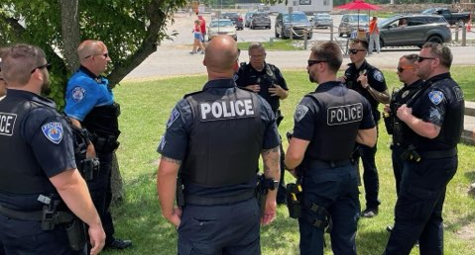
july 2023
SUMMERFEST & Parades
Hiring of Crossing Guards Burns & Lang
Defensive Tactics Team Hike & Training

Slide 10
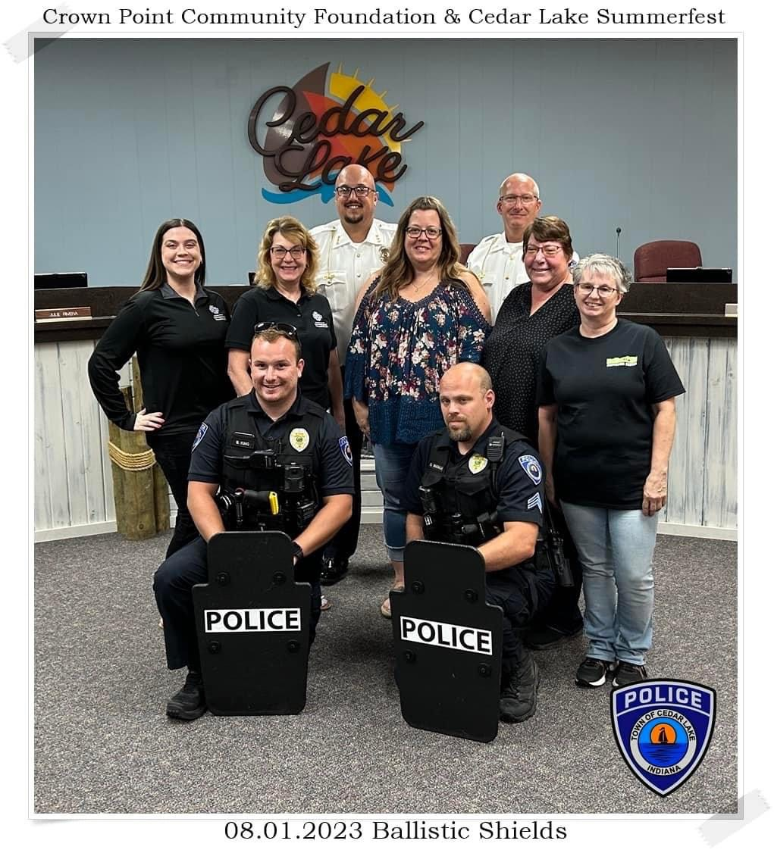
august 2023
08.01.23 Cedar Lake Summerfest and Crown Point Community Foundation Grant/Support funds to provide shields
08.01.23 Protecting K9 Heroes & Southern Lake County Conservation Club purchase K9 ballistic vest
08.01.23 Approved Regional Health partnership for support with crisis response teams
Lexipol Connection Recognition Program Silver Status Award Received
Too Good for Drugs program approved (replacing DARE)
NISOURCE/NIPSCO grant awarded for range equipment & community firearms safety program in July 2024
Added 3rd Crossing Guard Hunley

Slide 11
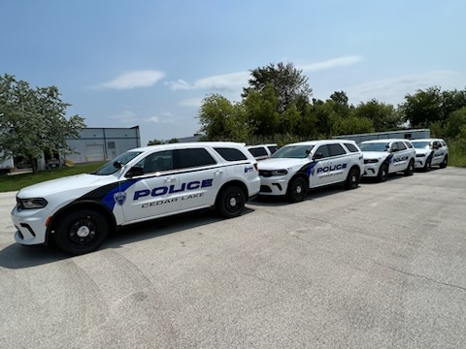
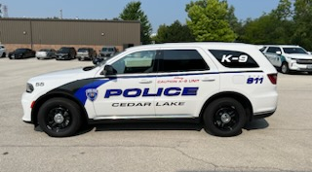
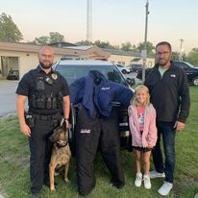
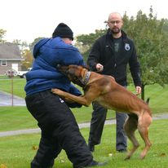
september 2023
New Vehicles: 37, 53, 55, 57
09.14.23 K9 Bite Suit donated by Jansma family
Reconstruction Team Approved

Slide 12
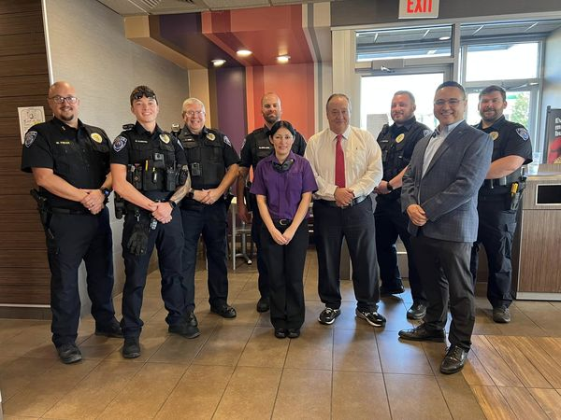
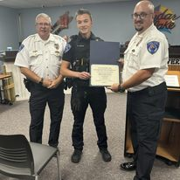
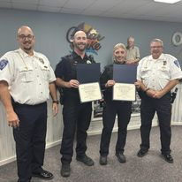
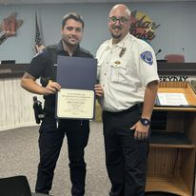
october 2023
10.13.23 Bash for the Blue & Camo 2 and present award to CEO Staci Goveia
Fire Department Open House
10.24.23 Coffee with a Cop
10.25.23 Lifesaving Awards: Officer McDowell (#44), Officer Dills (#53), Officer Kamstra (#54) and Officer Powell (#58)
Drug Take Back Program

Slide 13
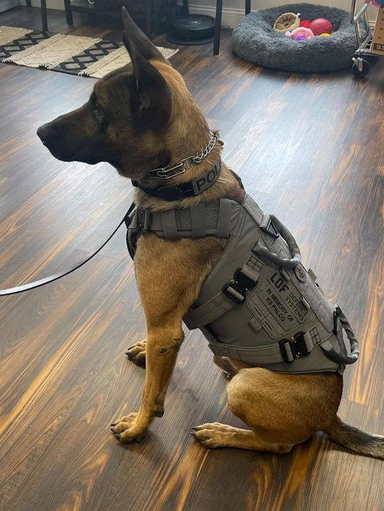
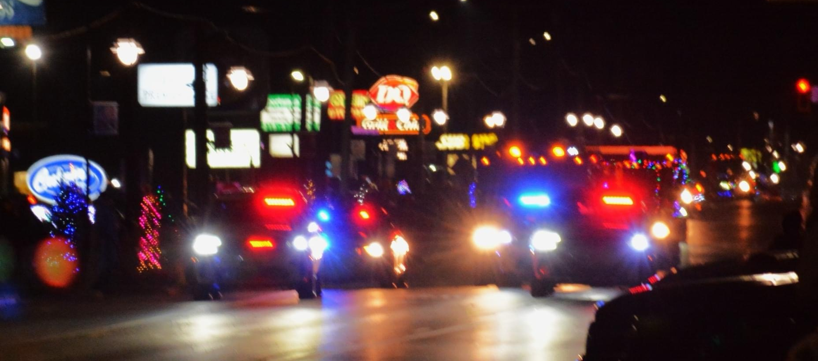
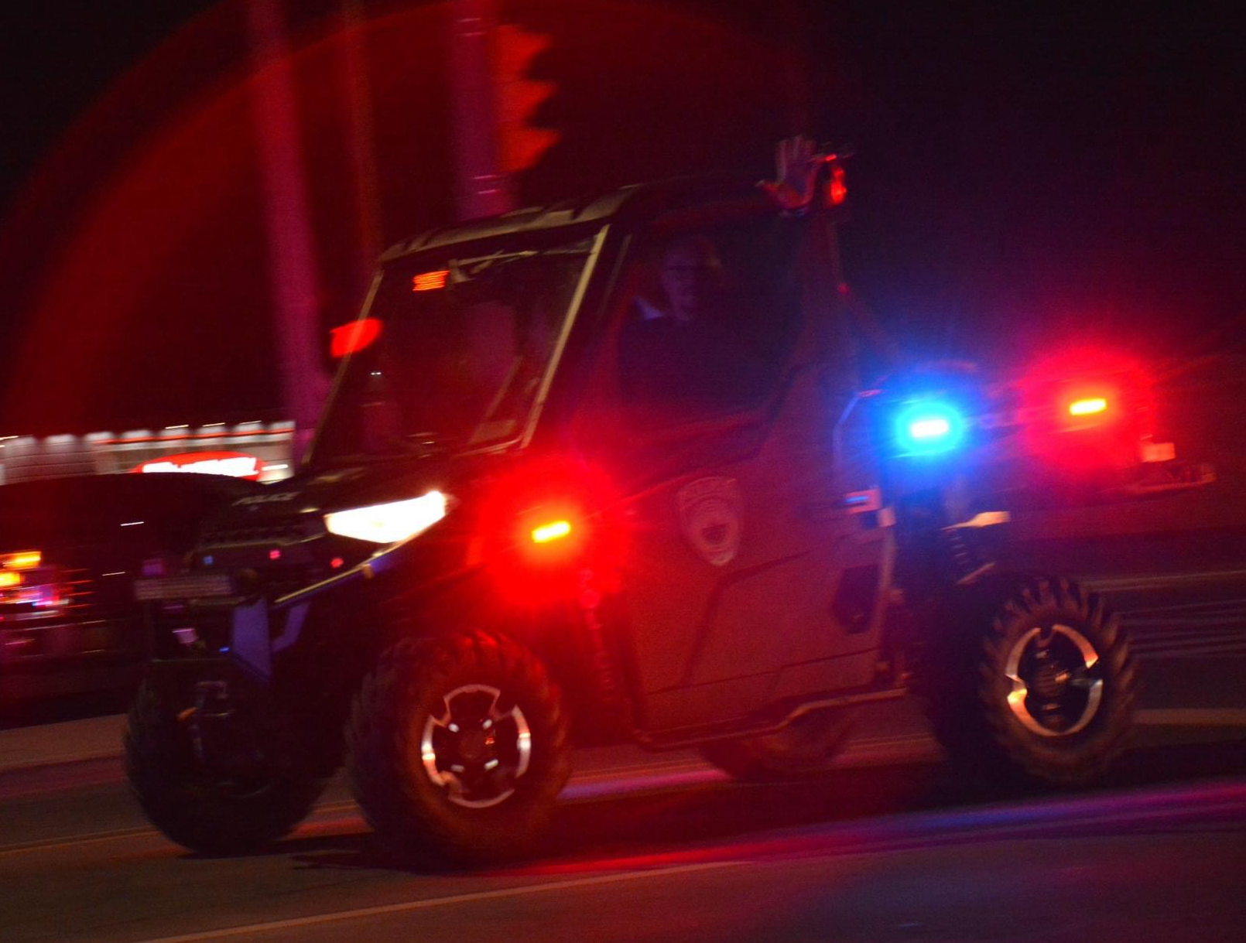
November 2023
11.17.23 Officer Stolarz graduates Academy
11.18.23 Parade of Lights
11.29.23 K9 Johnny receives ballistic vest

Slide 14
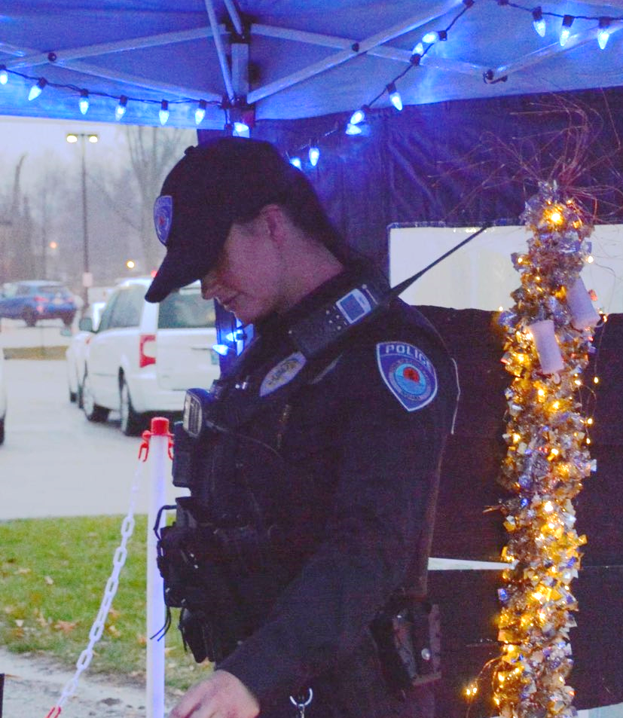
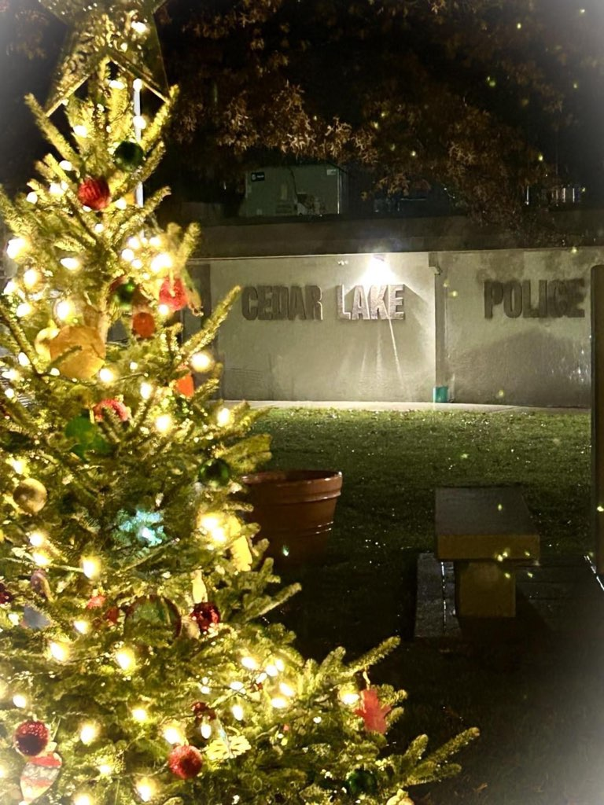
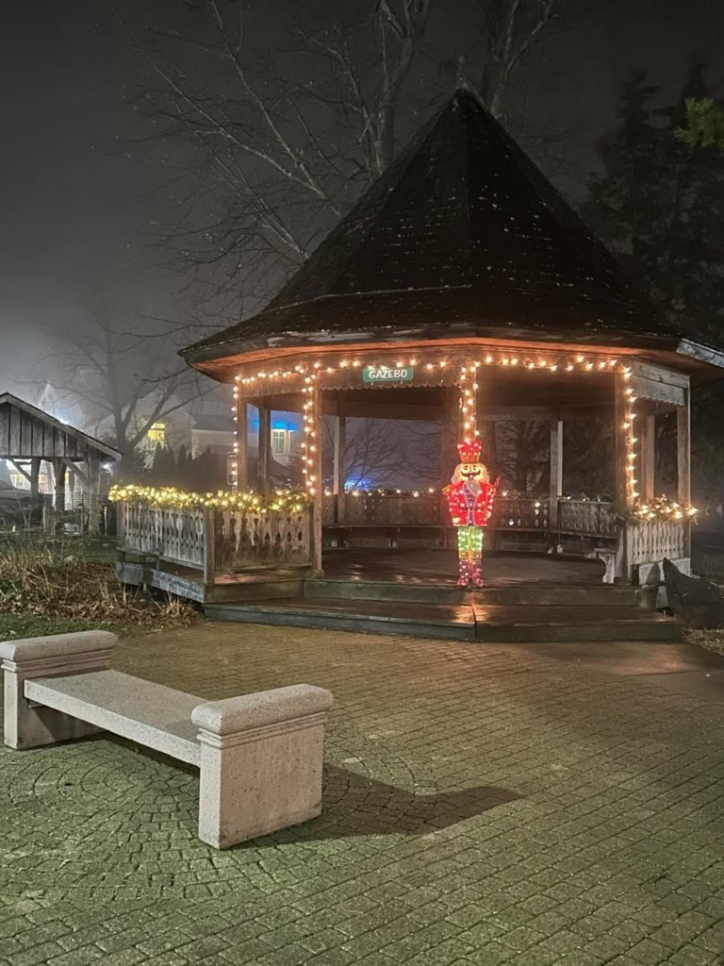
december 2023
Taylor Ice Festival
Supported NWI Regional SWAT annual fundraiser

Slide 15
5 YEAR REPORT COMPARISONS 2019 - 2023

Slide 16
INCIDENTS

Slide 17
ACCIDENTS

Slide 18
ARRESTS & CHARGES

Slide 19
CITATIONS & WARNINGS

Slide 20
ORDINANCE CITATIONS & WARNINGS

Slide 21
Cedar Lake Police Department
ADMINISTRATION:
Chief of Police – William Fisher
Deputy Chief of Police – Carl Brittingham
Patrol Commander – Thomas Kidd
Administrative Assistant – Sarah Moore

