Slide 1
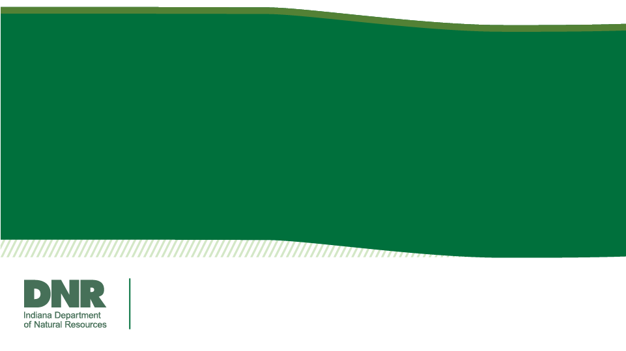
Cedar Lake
March 26, 2024
Tom Bacula
Fisheries Biologist
Division of Fish & Wildlife

Slide 2
Mission
The mission of the Division of Fish & Wildlife is to enrich the quality of life for present and future generations by balancing biological, recreational and economic benefits of Indiana’s fish, wildlife and their habitats.
Fisheries Biologist
Assist in the management of aquatic resources specifically fish and their habitat management by conducting fish populations surveys to provide recommendations on:
Stocking recommendations
Regulation proposal
Other management actions

Slide 3
Outline
2023 General Fisheries Survey
Past Fisheries Surveys
Whole Lake Fish Eradication
  What would occur
  Fish toxicant used
  Pros
  Cons
Alternate Management Options
Questions/Discussion

Slide 4
Outline
2023 General Fisheries Survey
Past Fisheries Surveys
Whole Lake Fish Eradication
  What would occur
  Fish toxicant used
  Pros
  Cons
Alternate Management Options
Questions/Discussion

Slide 5
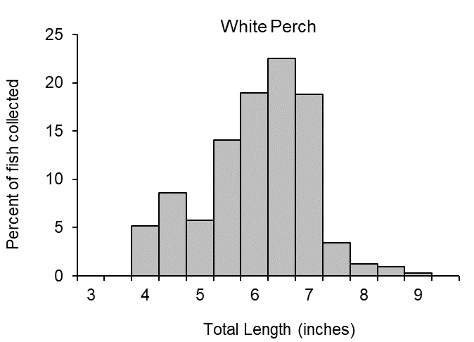
2023 Fisheries Survey
3,369 Total fish were collected
White Perch and Gizzard Shad undesirable to anglers and impact food web
Notes:
Sampling method: Electrofishing temporarily stuns the fish, gill nets open water fish, and trap nets near shore primarily panfish.
About 3,400 fish total across 22 species.
Mention the findings. Small white perch but very abundant. Shad are also abundant but not targeted by anglers. Both cause food web impacts. Carp are present and possibly detrimental, but their abundance isn’t very high.

Slide 6
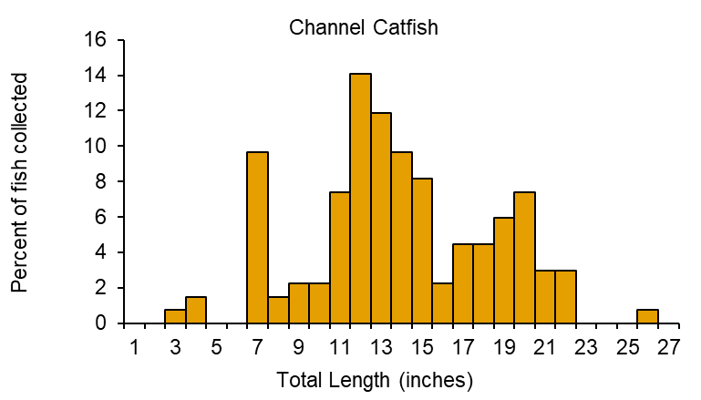
2023 Fisheries Survey
One of best Channel Catfish lakes in NWI
Mostly small Bluegill collected
Only 3 Largemouth Bass and 1 Smallmouth Bass
Notes:
Sport fish results. Channel Catfish growth appeared good with ages from 1 to 15 represented.
Mostly small bluegill and growth was average compared to other lakes.
In addition to those several Walleye were collected and a smallmouth bass of note. Additionally, sport fish were assigned ages to examine growth that can be compared.

Slide 7
Outline
2023 General Fisheries Survey
Past Fisheries Surveys
Whole Lake Fish Eradication
  What would occur
  Fish toxicant used
  Pros
  Cons
Alternate Management Options
Questions/Discussion

Slide 9
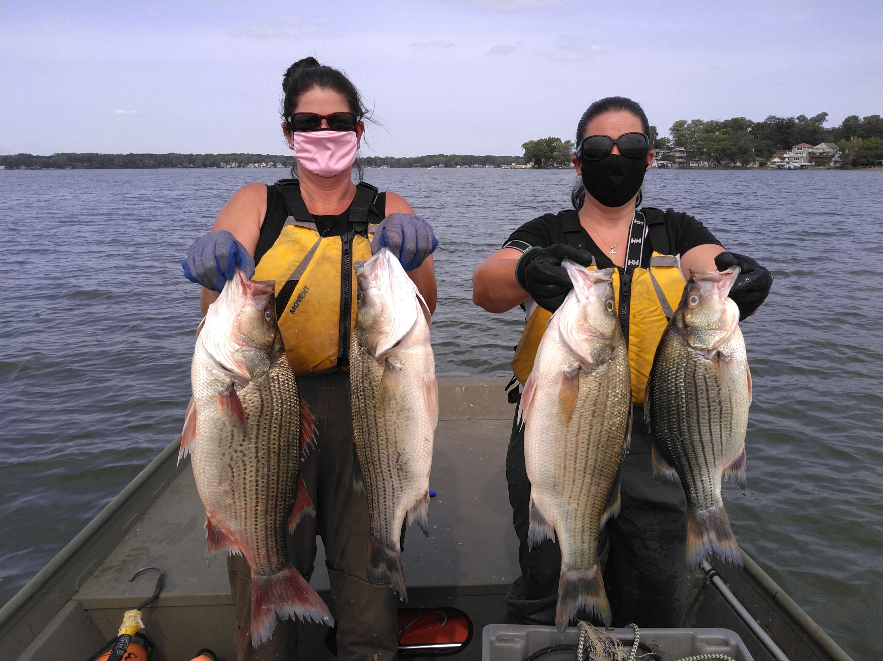
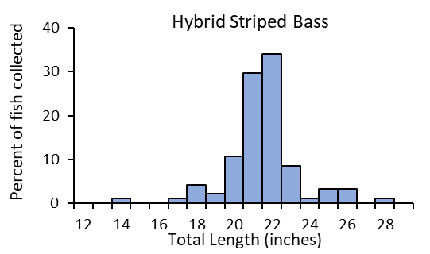
2020 Hybrid Striped Bass Survey
Total: 94 Hybrid Striped Bass
Length: 14.8 to 28.4”
  28.4” Largest for Cedar Lake survey and rare collection in Indiana
Annually stocked 7,810 fish averaging ~1.4”
Catch Rates
  2020: 15.7 fish/net lift
  2015: 19.8 fish/net lift
  2009: 8.9 fish/net lift
Photos by DFW
Notes:
Highlight management efforts to curb White Perch. Provides valuable fishery for big fish. Quite consistent for fall catch rates and good stocking success

Slide 10
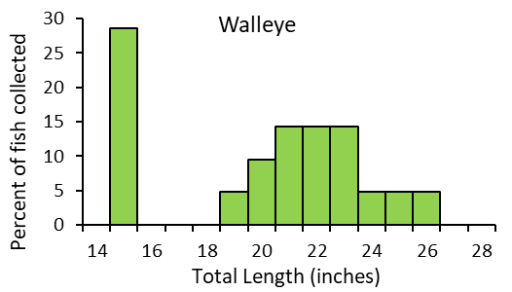
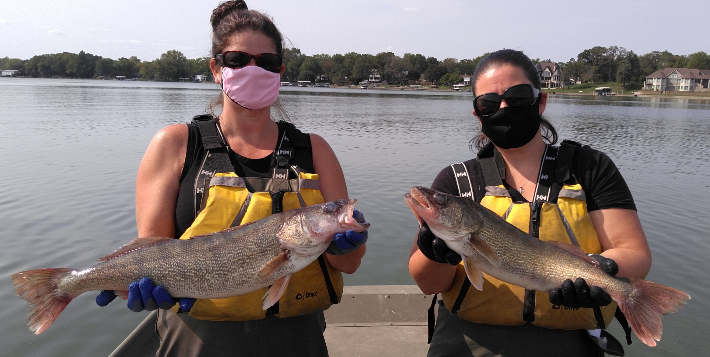
Fall Hybrid Bass
Surveys
Often collect Walleyes, in past Muskellunge
NO permitted stocking for these species
2020: 21 Walleye collected (15.0 to 26.0”)
2018: 10 Walleye (16.7 to 26.4”)
2009: 4 Walleye (10.9 to 21.3”)
2009: 4 Muskellunge (30.2 to 34.5”)
Photos by DFW

Slide 11
Outline
2023 General Fisheries Survey
Past Fisheries Surveys
Whole Lake Fish Eradication
  What would occur
  Fish toxicant used
  Pros
  Cons
Alternate Management Options
Questions/Discussion

Slide 12
Fish Eradication
The most extreme management action that can be undertaken
Solicit public input
  Meetings
  Angler creel surveys
Assume favorable
  Obtain permits
  Ramp up fish production for restocking efforts
  Develop plan for treatment
    Map watershed to ensure all water is treated
    Potentially treating Lake Dalecarlia
    Investigate potential for lowering lake to improve efficiency of treatment

Slide 13
Rotenone – Fish Toxicant
EPA registered fish toxicant, restricted use pesticide
Must have Category 5 pesticide license from IN State Chemist
Complete kill ~3ppm
  Cedar Lake estimate 7,000 gallons
  Lake Dalecarlia estimate 1,500 gallons
Largest renovation in the history of the state
DFW does not collect dead fish
Currently undergoing EPA reregistration, not currently produced nor known if it will again

Slide 14
Pro’s of Fish Eradication
No White Perch, Common Carp, or Gizzard Shad
Dredging, alum treatment and eradication will improve water clarity allowing plants to grow
Cedar Lake has a large shallow area with light can have a dense plant community
Sport fish will be restocked by DFW
  Concerns of continued illegal stocking

Slide 15
Con’s of Fish Eradication
Low likelihood of long-term success (15+ years)
  Common Carp are very difficult to eradicate
  Difficult to treat entire watershed
  Will need to include aerial application
Illegal stockings have undermined renovations success
Flooding can reintroduce species
Fishing will be nonexistent for at least 5 years
  Restocking ~6 years
  Without vegetation, habitat will continue to be limited
Notes:
Aerial application will be needed if possible with new potential rotenone restrictions
Once fish are in they can colonize quickly including nuisance species such as Carp or shad that reproduce very quick
Restocking uses most of the state produced fish

Slide 16
Outline
2023 General Fisheries Survey
Past Fisheries Surveys
Whole Lake Fish Eradication
  What would occur
  Fish toxicant used
  Pros
  Cons
Alternate Management Options
Questions/Discussion

Slide 17
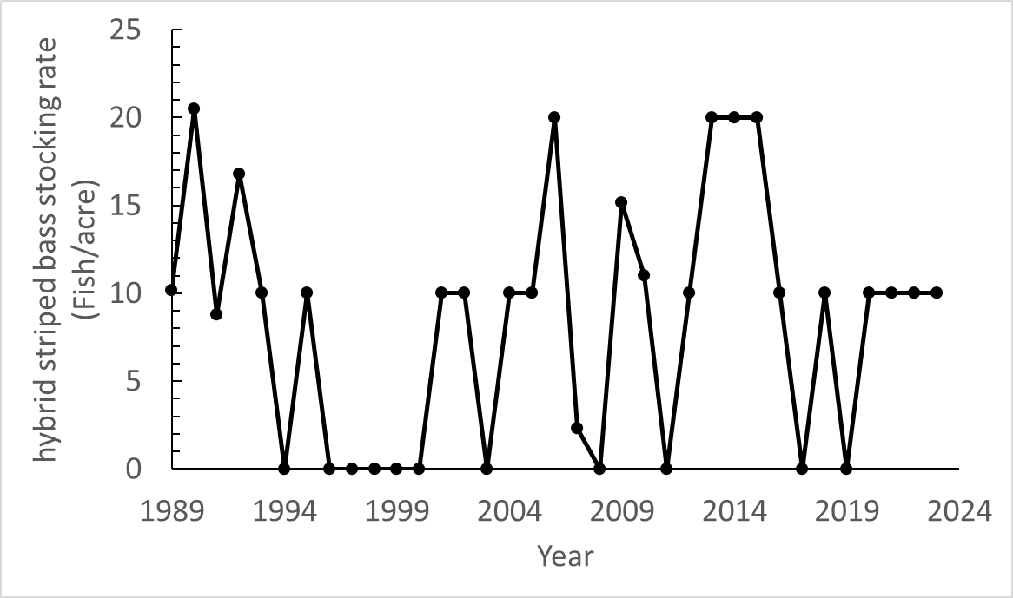
Alternate Fish Management Options
Increase hybrid striped bass stockings 10/acre up to 20/acre
  Benefits: additional predation on White Perch and Gizzard Shad
  Has been done
  Balance with other state fish stocking needs
  DFW continue monitoring for impacts

Slide 18
Alternate Fish Management Options
Other predators
  Walleye or hybrid walleye
    Further discussions on feasibilities with state hatcheries (limited production)
    Biologically will it help and not cause any harm (genetic implications)
    Also create additional recreational opportunities
  Largemouth Bass, Bluegill or crappie
    Limited habitat
    Stockings have not been successful in most situations

Slide 19
Local Options
Localized White Perch tournaments
  Unfortunately, not very large to fillet
  Good to eat
Bowfishing events for Common Carp
  Some anglers do target carp
  Impact water quality and fish populations in many locations
  Not the highest priority but could help

Slide 20
Questions/Discussion
Tom Bacula, Fisheries Biologist
Email: tbacula@dnr.IN.gov
Phone: 574-896-3673

