Slide 1

Town of Cedar Lake
Pay 2025 Budget Introduction
Presented by:
O.W. Krohn & Associates LLP
Corby Thompson, CPA cthompson@owkcpa.com

Slide 2


p2025 Introduction
Town of Cedar Lake
SUMMARY OF SELECT FUND CASH BALANCES
Fund |  | 6/30/2024 |  | 12/31/2023 |  | 12/31/2022 |  | 12/31/2021 |  | 12/31/2020 |  | 12/31/2019
General |  | $ 4,149,543 |  | $ 4,361,543 |  | $ 5,076,767 |  | $ 4,787,348 |  | $ 3,158,900 |  | $ 1,971,180
MVH (& MVH Restr.) |  | 957,325 |  | 861,575 |  | 578,388 |  | 422,107 |  | 334,570 |  | 376,311
LRS |  | 744,536 |  | 666,230 |  | 548,351 |  | 397,051 |  | 290,817 |  | 196,590
CCD |  | 397,325 |  | 484,786 |  | 414,960 |  | 383,756 |  | 338,149 |  | 278,328
CCI |  | 36,232 |  | 35,181 |  | 29,327 |  | 20,202 |  | 15,416 |  | 13,291
CEDIT |  | 787,110 |  | 640,939 |  | 532,147 |  | 754,196 |  | 624,532 |  | 469,480
LOIT Public Safety |  | 295,466 |  | 199,068 |  | 137,143 |  | 121,515 |  | 98,345 |  | 45,474
Casino Gaming |  | 147,590 |  | 179,784 |  | 107,447 |  | 220,383 |  | 232,340 |  | 226,527
Redev Gen |  | 119,779 |  | 106,533 |  | 91,570 |  | 54,372 |  | 19,579 |  | 11,263
Totals |  | $ 7,634,906 |  | $ 7,535,639 |  | $ 7,516,100 |  | $ 7,160,930 |  | $ 5,112,648 |  | $ 3,588,444

Slide 3
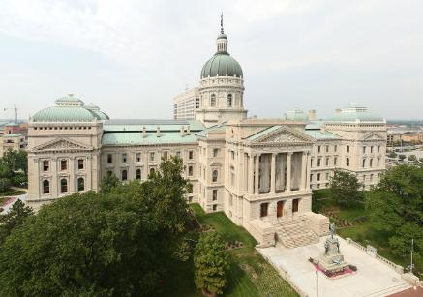
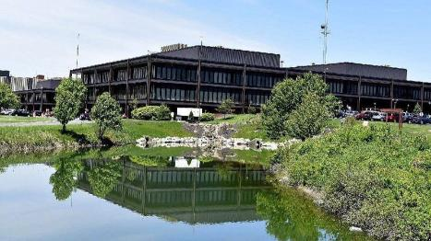
p2025 Introduction
Town of Cedar Lake
REVENUES
  Mostly given, maximized
    Property Tax Levies
      2025 three-year growth appeal
    Local income taxes (increased in comparison to ‘24 due to levy increases and county growth)
    Public works revs – MVH and LRS distributions
    Other miscellaneous income
  Increased planning, zoning and building fees
    Allows Town to prepare for growth and impacts of increasing population and required services
    Primary reason for increased cash balances; however, cash outflows may occur as service requirements precedes related levy and revenue adjustment

Slide 4
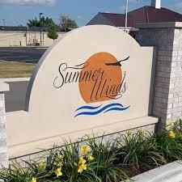
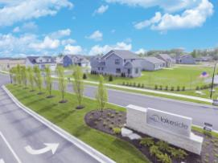
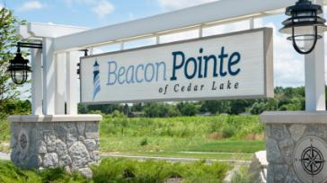
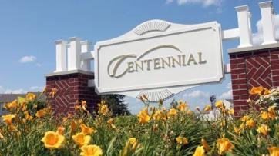
p2025 Introduction
Town of Cedar Lake
Qualified for Three-Year Growth Appeal - $423,411
  Recurring revenues
  To fund IT department and public safety wage increases
As CNAV goes up
Year |  | Assessed Value |  | Adjusmtents |  | Assessed Value |  | Increase
2024 |  | $ 953,451,766 |  | $ (763,400) |  | $ 952,688,366 |  | 1.0944 | 9.44%
2023 |  | 870,658,101 |  | (122,800) |  | 870,535,301 |  | 1.1692 | 16.92%
2022 |  | 744,576,738 |  | - |  | 744,576,738 |  | 1.1227 | 12.27%
2021 |  | 663,205,480 |  | - |  | 663,205,480
Town three-year average growth |  |  |  |  |  |  |  | 1.1288 | 12.88%
Property tax rates go down
Growth appeal is to allow operating levy to adjust in proportion to CNAV increase which allows the operating tax rate to keep level in the long-run

Slide 5
p2025 Introduction
Town of Cedar Lake

Slide 6

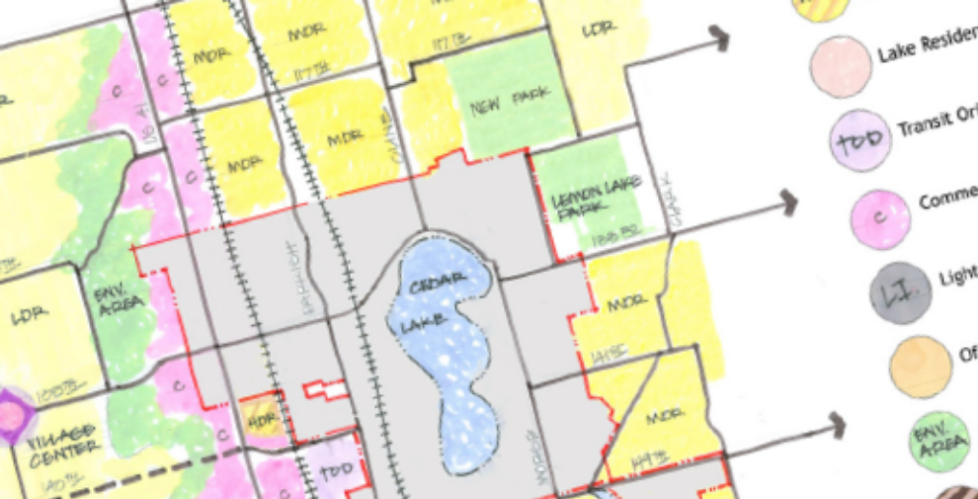
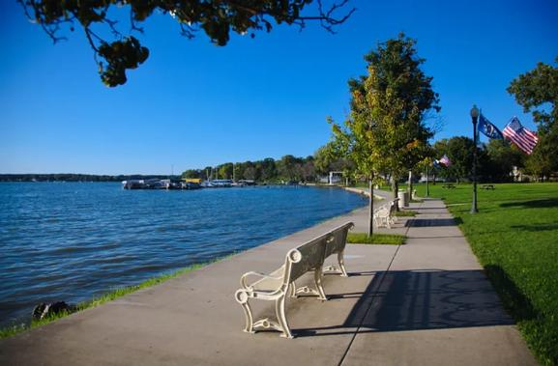


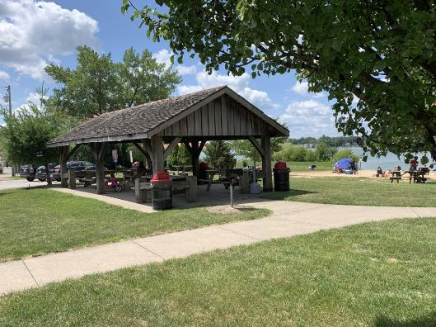
p2025 Introduction
Town of Cedar Lake
  With growth comes increased needs

Slide 7


p2025 Introduction
Town of Cedar Lake
  APPROPRIATIONS – General Fund
    Overall, a 4.8% increase is proposed for 2025 in comparison to 2024
    In general, a 3% cost-of-living adjustment has been assumed for wages
    Town Administration
      Clerk-Treasurer Department
        Proposed increased pay for positions based on accreditations
      Town Council Budget
        IT Department separation to its own department
        Increased health insurance premiums (7.1% budgeted)
        Reductions to professional services – funding to come from other eligible funds
      Planning, Zoning and Building Department
        Pay reallocations to better align duties and services with civil funds
        Increased appropriations for engineering and unsafe building needs
      IT Department has new, separate appropriation lines based on needs
        ~$150k budget for 2 staff, supplies and services (services primarily IT contracts)
      Continued PSAP contract payment of $150,000

Slide 8


p2025 Introduction
Town of Cedar Lake
APPROPRIATIONS – General Fund
  Police Department (budget increase of 6.3%)
    Budget for 25 full-time officers; one new hire OR additional wage increase
      Potential for LIT-Public Safety funding if current estimates come to fruition
    New appropriation lines for utility costs for new, separate facilities from Town Hall
    Increased vehicle service costs and travel appropriations
    Increased dues and subscriptions based on current needs
  Fire Department (budget increase of 9.4%)
    Budget for 16 full-time fire officers; no new hires
      Continued shortfalls in overtime and part-time help has caused need for additional appropriations here
    Increase in supplies of $10,000 (inflationary needs)
    Increase in instruction/training for replacement/new hire needs
    Increase in repairs costs and utilities lines for new facilities

Slide 9


p2025 Introduction
Town of Cedar Lake
APPROPRIATIONS – General Fund
  Park Budget – New Department in 2023
    Overall, budget decrease of approximately 7.6%
    Mostly adjustments based on actual needs
    Personal Services (~$501k)
      Superintendent and Recreation Coordinator
      Full-Time Grounds Crew (3) and Part-Time Crew (as needed)
      Full-Time Administrative Assistant
    Supplies (~$98k)
      Operating Supplies
      Fuel
      Parts & Tools
    Services and Charges (~$237k)
      Professional services (for Park Master Plan)
      Equipment and grounds maintenance
      Utilities and miscellaneous
    Capital Outlays (~$105k)
      For initial equipment and facilities improvements

Slide 10

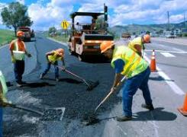
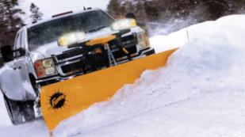
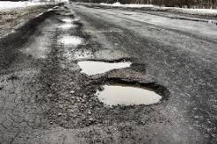
p2025 Introduction
Town of Cedar Lake
APPROPRIATIONS – MVH and LRS
  Public Works Salaries and Wages
    Primarily COL adjustments of 3% for public works employees
    Additional utility employees are proposed with 25% allocated to MVH
      One sewer and one water (both with 25% allocated to MVH)
  MVH budget increased by approximately $37,000 or 4.2%
    Primarily for additional employee allocations, vehicle maintenance and training appropriation increases
  LRS budget increased by $60,000
    Additional equipment and vehicle capital outlays are provided as cash reserves continue to increase

Slide 11
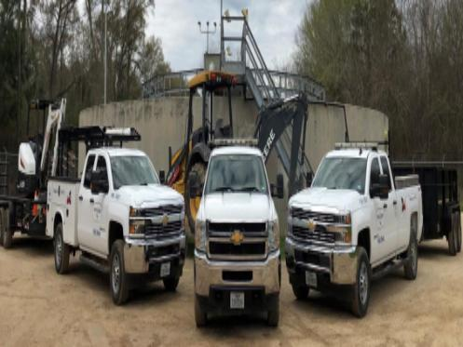
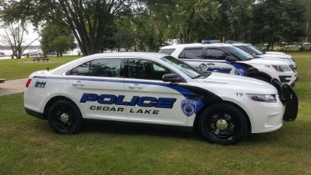
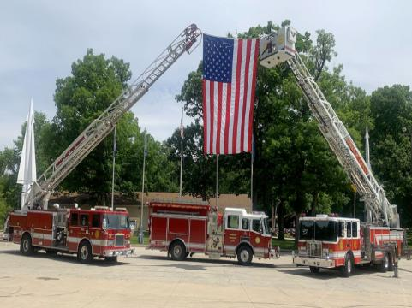
p2025 Introduction
Town of Cedar Lake
APPROPRIATIONS – Cumulative Funds
  CCD – Serves as Capital Equipment Replacement Fund
    Appropriations of $175,800 for current police vehicle needs
      For current police vehicle leases
      Additional police vehicle purchases require alternative funding
    Appropriations for current fire vehicle and equipment leases
      Fire truck, ambulance and related equipment leases
    Public works allowance of $240,000 provided
      Deteriorating equipment has caused significant needs
      LRS appropriations are available as well
  CCI budget has no major changes
    IT, software and computer equipment are budgeted

Slide 12
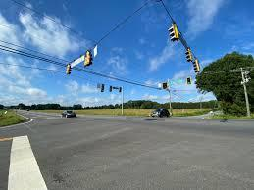

p2025 Introduction
Town of Cedar Lake
APPROPRIATIONS – Local Income Tax Funds
  CEDIT (LIT – Economic Development)
    2015 Road Bond; final maturity in 2025
    Significant increases for one-off or periodic reports, such as road impact or other major engineering/consulting studies
    Potential for additional bond for payment of road improvements with current and estimated CEDIT distributions
  LOIT Public Safety (LIT – Public Safety)
    Pays major portion of PSAP contract - $375,000 budgeted for 2025 (increase of $100k)
      Depending on Town needs, amounts can be reallocated for additional public safety wages or capital needs if cashflow allows
    $150,000 of PSAP contract also budgeted in General Fund

Slide 13
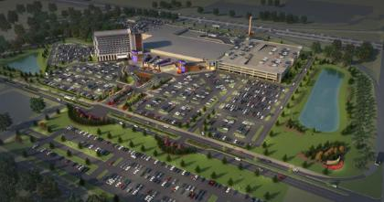
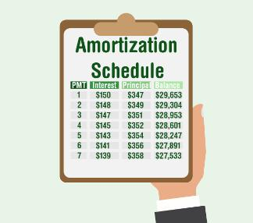
p2025 Introduction
Town of Cedar Lake
APPROPRIATIONS – Other Funds
  Casino Gaming Fund
    Miscellaneous professional services and improvements budgeted (~$50k)
    Per sustain plan, funds are to build for future capital needs
  Debt Service Funds
    Debt service funds are budgeted based on their
amortization schedules and payments due
  Redevelopment General
    No major changes

Slide 14
p2025 Introduction
Town of Cedar Lake

Slide 15
p2024 Introduction
Town of Cedar Lake
Questions/comments/discussion?

