Slide 1
Town of Cedar Lake
Pay 2024 Budget Introduction
Presented by:
O.W. Krohn & Associates LLP Corby Thompson, CPA cthompson@owkcpa.com

Slide 2
p2024 Introduction
Town of Cedar Lake
SUMMARY OF SELECT FUND CASH BALANCES
Fund | 6/30/2023 | 12/31/2022 | 12/31/2021 | 12/31/2020 | 12/31/2019 | 12/31/2018
General | $ 4,833,150 | $ 5,076,767 | $ 4,787,348 | $ 3,158,900 | $ 1,971,180 | $ 1,404,380
MVH | 759,888 | 578,388 | 422,107 | 334,570 | 376,311 | 357,719
LRS | 560,255 | 548,351 | 397,051 | 290,817 | 196,590 | 181,750
CCD | 381,388 | 414,960 | 383,756 | 338,149 | 278,328 | 149,827
CCI | 32,184 | 29,327 | 20,202 | 15,416 | 13,291 | 19,048
CEDIT | 631,842 | 532,147 | 754,196 | 624,532 | 469,480 | 365,850
LOIT Public Safety | 194,497 | 137,143 | 121,515 | 98,345 | 45,474 | 60,727
Casino Gaming | 123,585 | 107,447 | 220,383 | 232,340 | 226,527 | 325,349
Redev Gen | 103,344 | 91,570 | 54,372 | 19,579 | 11,263 | 22,031
Totals | $ 7,620,133 | $ 7,516,100 | $ 7,160,930 | $ 5,112,648 | $ 3,588,444 | $ 2,886,681

Slide 3
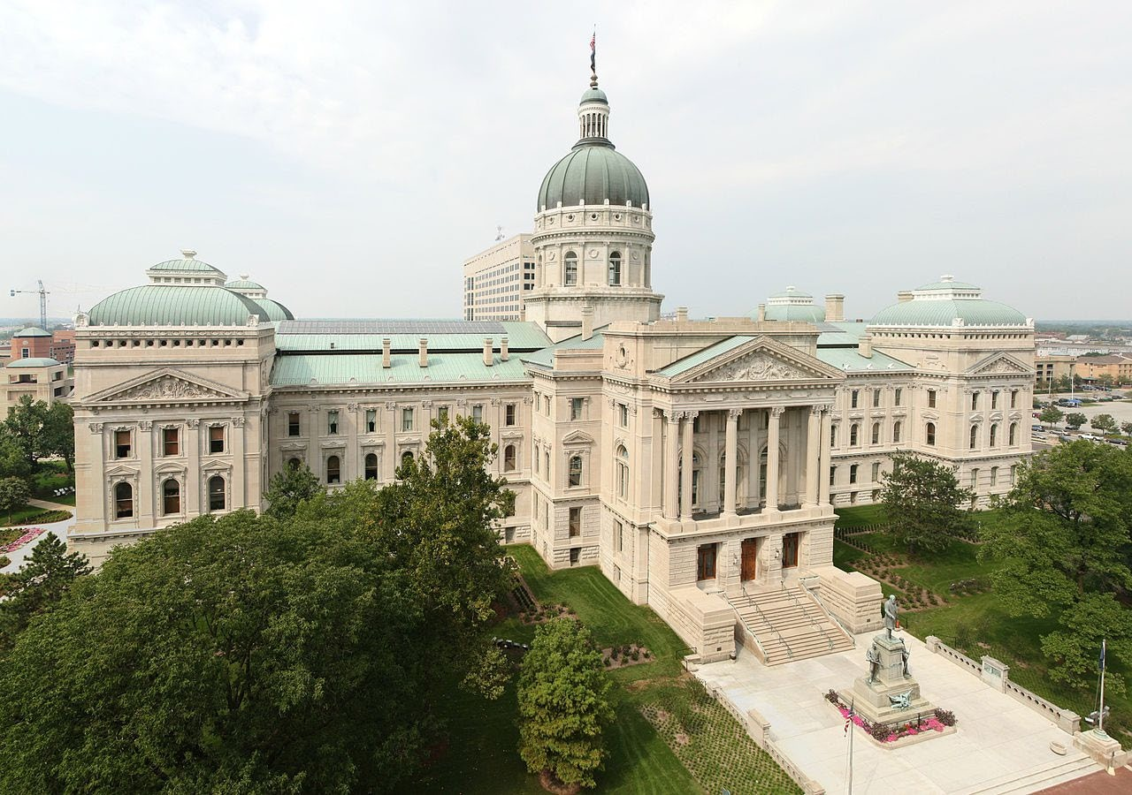
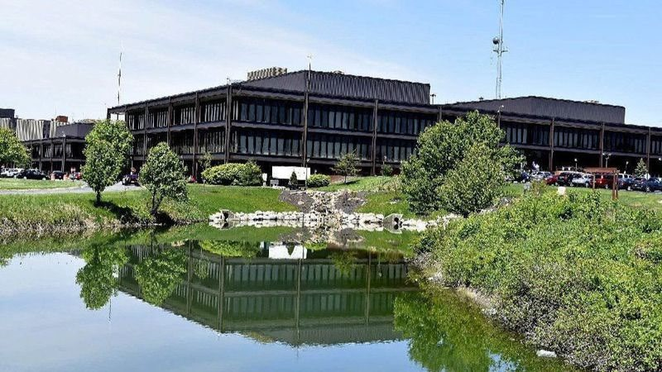
p2024 Introduction
Town of Cedar Lake
REVENUES
Mostly given, maximized
Property Tax Levies
2024 three-year growth appeal
Local income taxes (increased in comparison to ‘22 due to levy increases)
MVH and LRS distributions
Other miscellaneous income
Increased planning, zoning and building fees
Allows Town to prepare for growth and impacts of increasing population and required services
Primary reason for increased cash balances; however, cash outflows may occur as service requirements precedes related levy and revenue adjustment

Slide 4
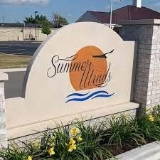
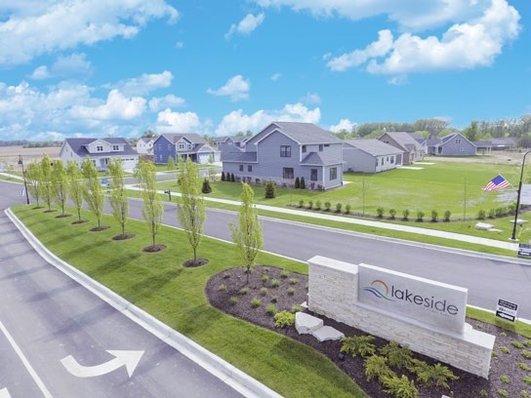
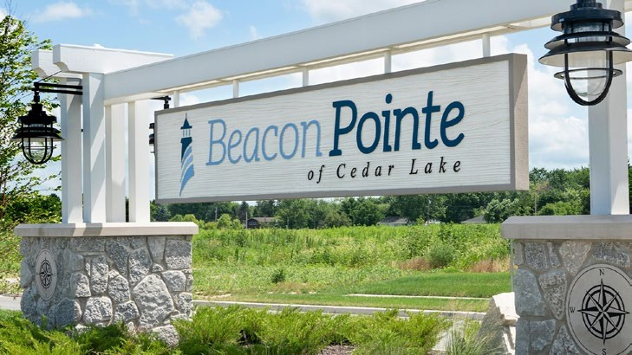
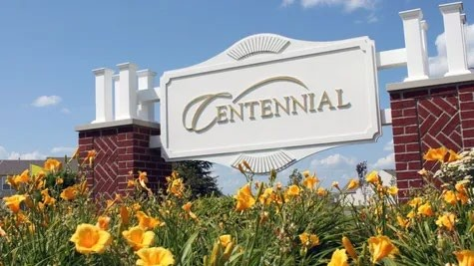
p2024 Introduction
Town of Cedar Lake
Qualified for Three-Year Growth Appeal - $389,654
Recurring revenues
To fund 2 additional fire fighters, GIS coordinator and certified mechanic
As CNAV
goes up
THREE-YEAR GROWTH APPEAL - CALCULATIONS
 | Town | Annexation | Adjusted Town
Year | Assessed Value | Adjusmtents | Assessed Value | Increase
2023 | $ 870,658,101 | $ (122,800) | $ 870,535,301 | 1.1692 | 16.92%
2022 | 744,576,738 | - | 744,576,738 | 1.1227 | 12.27%
2021 | 663,205,480 | - | 663,205,480 | 1.1059 | 10.59%
2020 | 600,232,689 | (517,800) | 599,714,889
Town three-year average growth |  |  |  | 1.1326 | 13.26%
Property tax rates go down
Growth appeal is to allow operating levy to adjust in proportion to CNAV increase which allows the operating tax rate to keep level in the long- run

Slide 5
p2024 Introduction
Town of Cedar Lake
ACTUAL AND PROJECTED CNAV AND PROPERTY TAX RATES
$1,200,000,000
$0.9000
$0.8083
$0.8122
$0.7916
$0.8085
$0.8055
$0.7934
$0.8000
$1,000,000,000
$0.7024
$0.6401
$0.6657
53,451,
$0.7000
$0.5772
70,658,
$800,000,000
$0.5663
$0.6000
44,576,
63,205,
$0.5000
$600,000,000
00,232,
$1,135,576,308
21,450,
56,389,
$1,010,658,872
$1,071,298,404
$0.4000
91,469,
$9
766
$400,000,000
8
101
$0.3000
7
738
$6
689
$6
480
$4
612
$5
089
$5
622
$0.2000
$200,000,000
$0.1000
$-
2017
2018
2019 2020
Certified Net Assessed Value
2021 2022 2023
Projected Certified Net Assessed Value
2024
2025
2026
2027
$-
Property Tax Rate

Slide 6
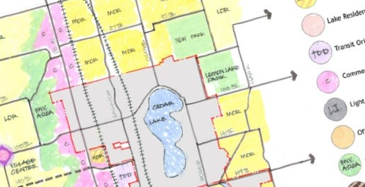
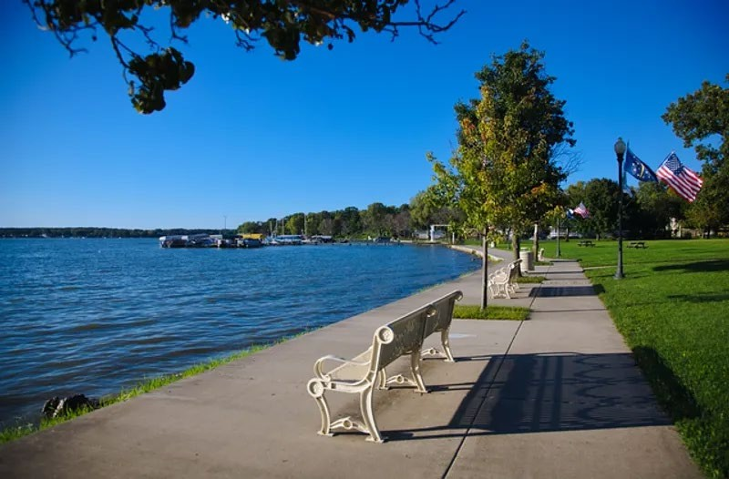
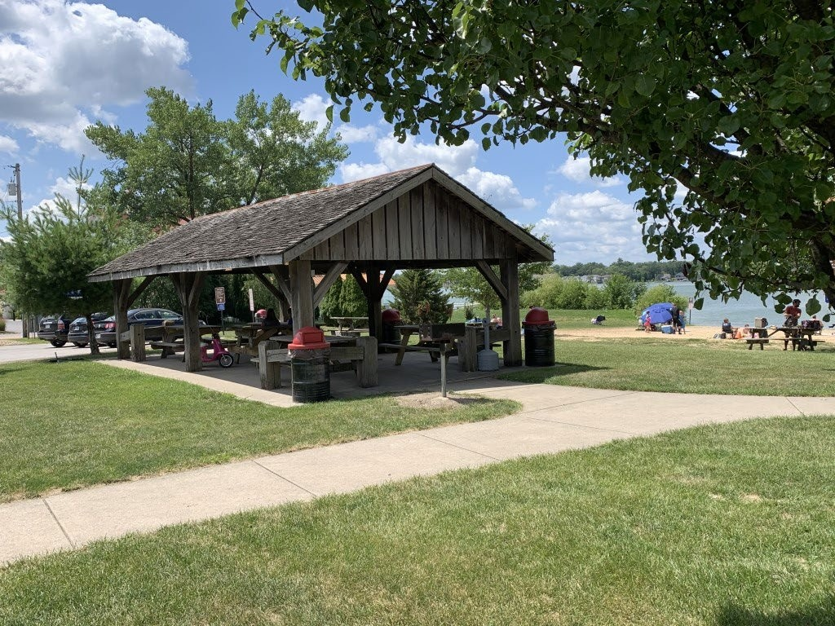
p2024 Introduction
Town of Cedar Lake
With growth comes increased needs

Slide 7
p2024 Introduction
Town of Cedar Lake
APPROPRIATIONS – General Fund
Overall, a 4.2% increase is proposed for 2024
In general, a 3% cost-of-living adjustment has been assumed for wages
Town Administration
Clerk-Treasurer Department
Some minor pay reallocations, no major updates
Town Council Budget
Hiring of full-time GIS coordinator
Anticipated increases in health insurance premiums for new hires and inflationary adjustments included
Planning, Zoning and Building Department
Pay reallocations to better align duties and services with civil funds
Certain IT and other service estimates overstated, reduced based on actual amounts
Continued PSAP contract payment of $150,000

Slide 8
p2024 Introduction
Town of Cedar Lake
APPROPRIATIONS – General Fund
Police Department (budget increase of 7.7%)
Budget for 24 full-time officers; no new hires
Potential for LIT-Public Safety funding if current estimates come to fruition
Increase in fuel costs of $70,000 due to loss of E-85 grants
Increased vehicle service costs and new utilities line if new facilities ready
Equipment lines moved to CCD fund
Fire Department (budget increase of 8.1%)
Budget for 16 full-time fire officers; two new hires
Potential for certain promotions if authorized by BOS and Council
Increase in fuel costs of $15,000
Increased repairs costs and utilities line if new facilities ready
Equipment lines moved to CCD fund

Slide 9
p2024 Introduction
Town of Cedar Lake
APPROPRIATIONS – General Fund
Park Budget – New Department in 2023
Payable via Extension of Services Levy
Personal Services (~$463k)
Superintendent and Recreation Coordinator
Full-Time Grounds Crew (3) and Part-Time Crew (as needed)
Full-Time Administrative Assistant
Supplies (~$78k)
Operating Supplies
Fuel
Parts & Tools
Services and Charges (~$255k)
Professional services (for Park Master Plan)
Equipment and grounds maintenance
Utilities and miscellaneous
Capital Outlays (~$185k)
For initial equipment and facilities improvements

Slide 10
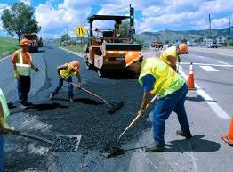
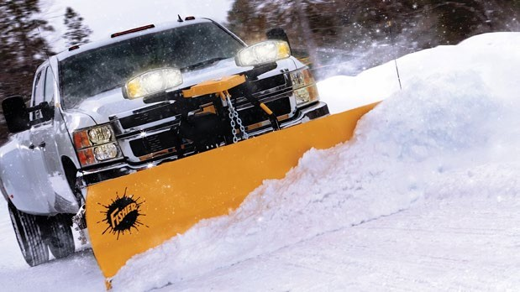
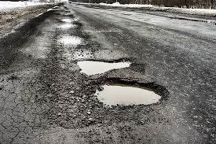
p2024 Introduction
Town of Cedar Lake
APPROPRIATIONS – MVH and LRS
Public Works Salaries and Wages
Primarily COL adjustments of 3% for public works employees
Includes hiring of full-time certified mechanic
Wage reallocations from utilities included
MVH budget increased by approximately $249,000 or 39.5%
Primarily for mechanic, some inflationary increases and increased MVH distributions requiring disbursement
LRS budget increased by $10,000
Additional $10,000 for contracted road maintenance services

Slide 11
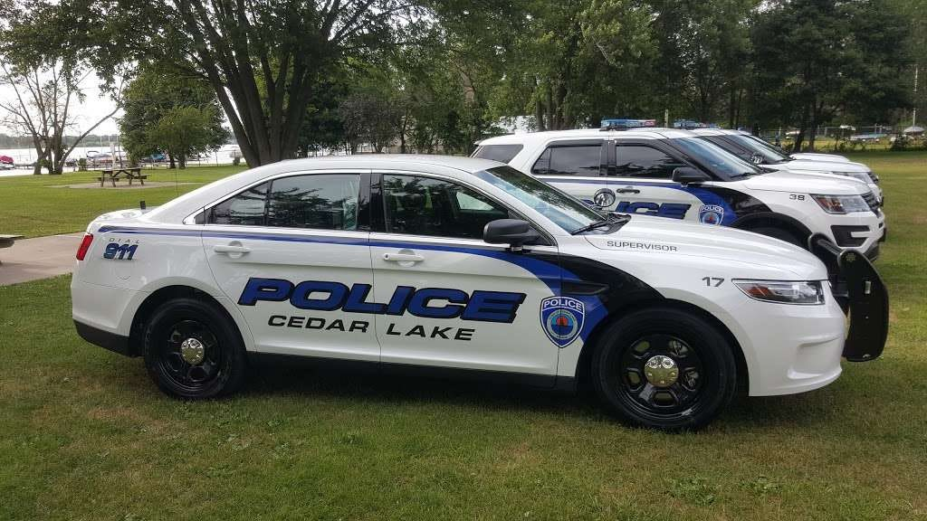
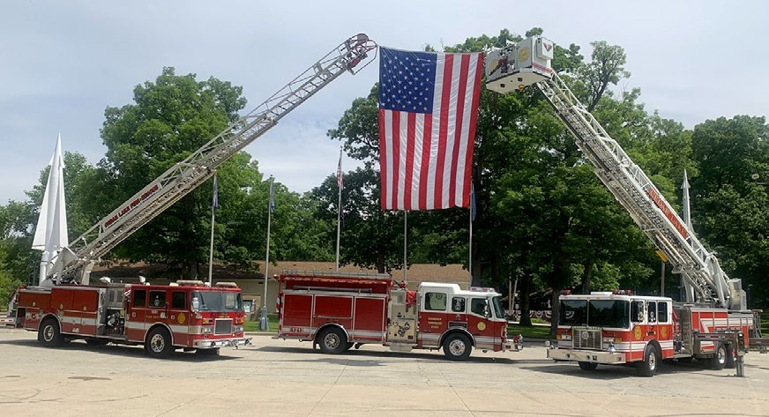
p2024 Introduction
Town of Cedar Lake
APPROPRIATIONS – Cumulative Funds
CCD – Serves as Capital Equipment Replacement Fund
Appropriations of $346,000 for current police vehicle needs
For current police vehicle leases
Then, remaining amount can be used for purchases
Appropriations for current fire vehicle and equipment leases
Fire truck, ambulance and related equipment leases
Includes purchase of fire safety vehicle
Public works allowance of $30,000 provided, additional equipment appropriations in MVH and LRS are available as well
Appropriations for equipment allowances shifted from General fund
CCI budget has no major changes
IT, software and computer equipment are budgeted

Slide 12
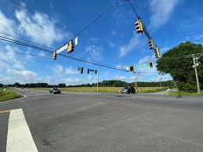
p2024 Introduction
Town of Cedar Lake
APPROPRIATIONS – Local Income Tax Funds
CEDIT (LIT – Economic Development)
2015 Road Bond; final maturity in 2025
Significant increases for one-off or periodic reports, including road impact study
Potential for additional bond for payment of road improvements with current and estimated CEDIT distributions
LOIT Public Safety (LIT – Public Safety)
Pays major portion of PSAP contract - $275,000 budgeted for 2024
($150,000 of PSAP contract also budgeted in General Fund)
Potential for large reduction in costs if were to join County
Would allow for either hiring of additional officers or provide relief to General Fund

Slide 13
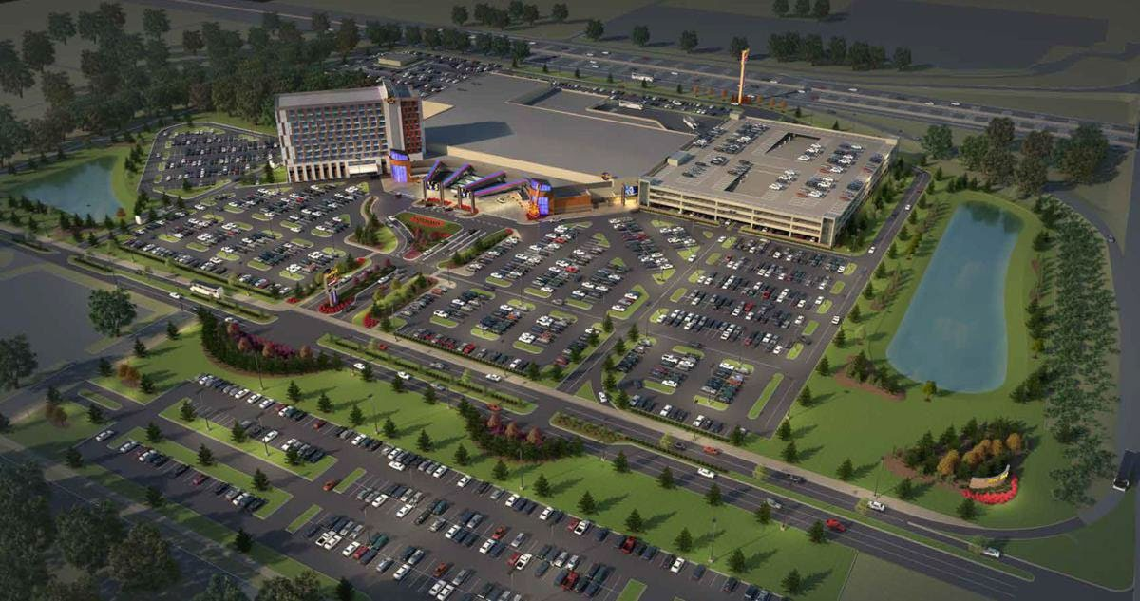
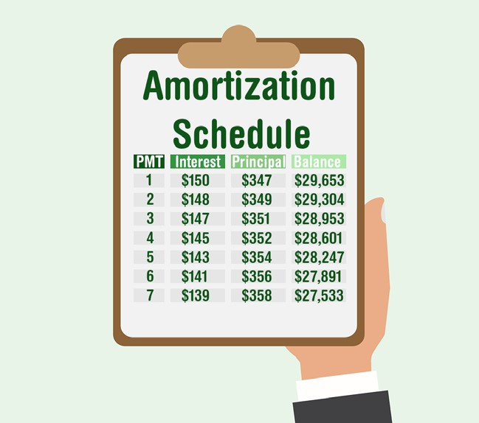
p2024 Introduction
Town of Cedar Lake
APPROPRIATIONS – Other Funds
Casino Gaming Fund
Miscellaneous professional services and improvements budgeted (~$50k)
Per sustain plan, funds are to build for future capital needs
Debt Service Funds
Debt service funds are budgeted based on their amortization schedules and payments due
Redevelopment General
No major changes

Slide 14
p2024 Introduction
Town of Cedar Lake
SUMMARY OF PROJECTED CASH BALANCES - CHART
- per Sustainability Plan dated September 29, 2023 -
Total Selected Cash
$10,347,463
$10,000,000
Total Selected Cash
$9,263,844
TIF; $1,681,357
Total Selected Cash
Total Selected Cash
TIF; $389,496
$8,555,390
Total Selected Cash
$8,413,449
$8,727,282
Other; $370,541
Other; $463,983
Total Selected Cash
Total Selected Cash
Total Selected Cash
$7,546,286
$7,959,884
$8,039,358
$8,000,000
TIF; $1,179,030
Capital/Cumulative
Other; $208,640
TIF; $2,084,672
TIF; $2,997,127
TIF; $1,188,061
Capital/Cumulative
$2,206,859
TIF; $2,142,769
$2,689,059
TIF; $2,654,115
Other; $153,477
Capital/Cumulative
Other; $182,389
$6,000,000
Total Selected Cash
Road and PW
$2,001,178
Other; $148,369
Other; $74,345
$5,304,555
Road and PW
$1,126,739
Capital/Cumulative
Other; $112,366
TIF; $778,310
Capital/Cumulative
$819,158
Road and PW
$1,710,737
Capital/Cumulative
$2,420,461
$611,382
$1,721,717
Capital/Cumulative
Capital/Cumulative
Other; $50,145
Road and PW
$1,478,193
$1,934,478
$4,000,000
$671,247
Road and PW
Capital/Cumulative
Road and PW
$668,460
Road and PW
Road and PW
$1,932,018
$625,387
$802,436
$810,321
Road and PW
General
General
General
$572,902
$4,787,348
$5,076,767
$4,555,160
$2,000,000
General
General
General
$3,764,404
$3,278,569
General
General
General
$3,158,900
$2,992,248
$2,911,011
$1,971,180
$-
2019
2020
2021
2022
2023
2024
2025
2026
2027
General
Road and PW
Capital/Cumulative
Other
TIF
Total Selected Cash

Slide 15
p2024 Introduction
Town of Cedar Lake
Questions/comments/discussion?

