Slide 1

Town of Cedar Lake
Pay 2022 Budget Public Hearing
Presented by:
O.W. Krohn & Associates LLP
Corby Thompson, CPA cthompson@owkcpa.com

Slide 2


p2022 Public Hearing
Town of Cedar Lake
TOWN OF CEDAR LAKE
SUMMARY OF SELECT FUND CASH BALANCES
Fund |  | 6/30/2021 |  | 12/31/2020 |  | 12/31/2019 |  | 12/31/2018
General |  | $ 4,551,919 |  | $ 3,158,900 |  | $ 1,971,180 |  | $ 1,404,380
MVH |  | 65,235 |  | 334,570 |  | 376,311 |  | 357,719
LRS |  | 324,208 |  | 290,817 |  | 196,590 |  | 181,750
CCD |  | 378,518 |  | 338,149 |  | 278,328 |  | 149,827
CCI |  | 17,789 |  | 15,416 |  | 13,291 |  | 19,048
CEDIT |  | 712,407 |  | 624,532 |  | 469,480 |  | 365,850
LOIT Public Safety |  | 36,321 |  | 98,345 |  | 45,474 |  | 60,727
Casino Gaming |  | 237,737 |  | 232,340 |  | 226,527 |  | 325,349
Redev Gen |  | 44,820 |  | 19,579 |  | 11,263 |  | 22,031
Totals |  | $ 6,368,954 |  | $ 5,112,648 |  | $ 3,588,444 |  | $ 2,886,681

Slide 3
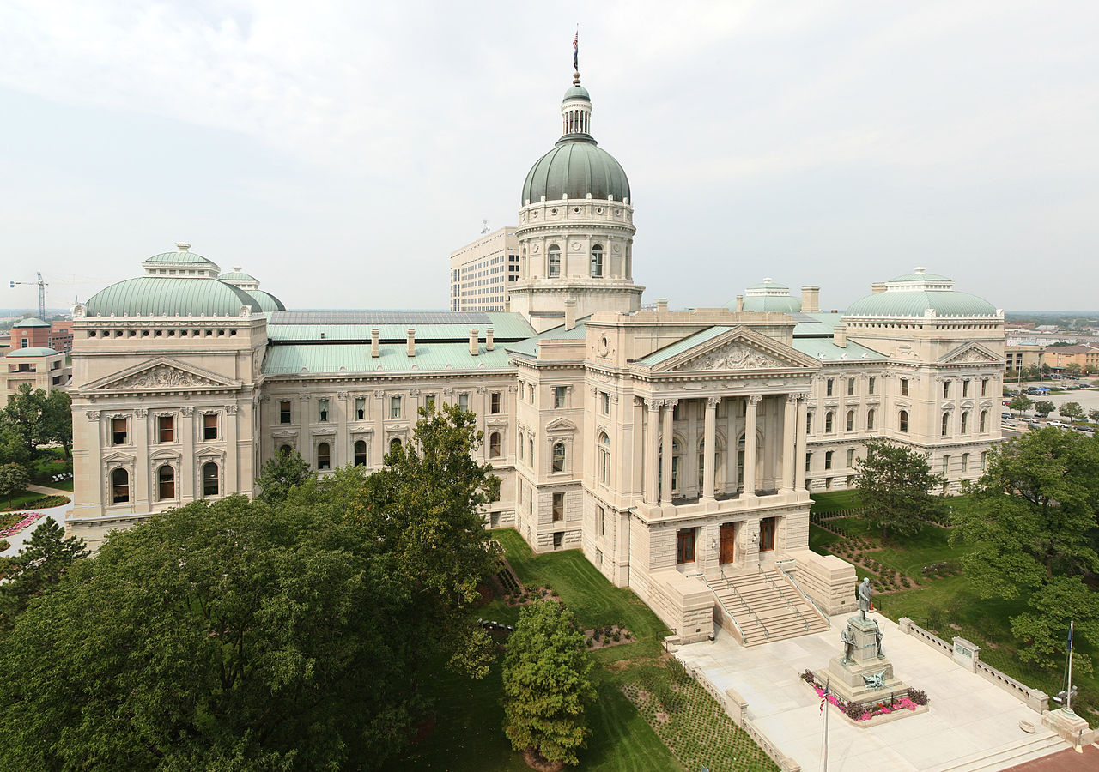

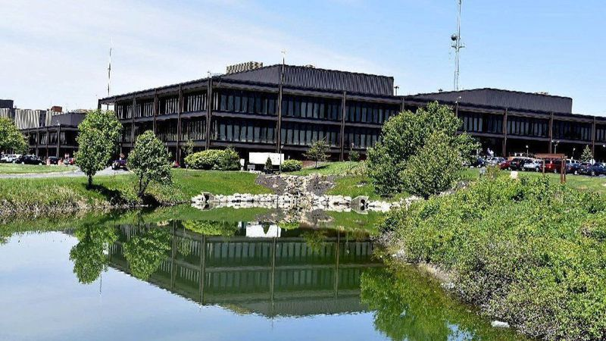
p2022 Public Hearing
Town of Cedar Lake
REVENUES
  Mostly given, maximized – allocation control
    Levy
    Local income taxes
    MVH and LRS distributions
    Other miscellaneous income
  Fire protection and fire response fees
    Should provide $60,000 for new fire fighter salary
  Increased EMS billings up in comparison to Sustainability Plan
  Increased planning, zoning and building fees
    Allows Town to prepare for growth and impacts of increasing population and required services
  COVID impacts, still recovering

Slide 4
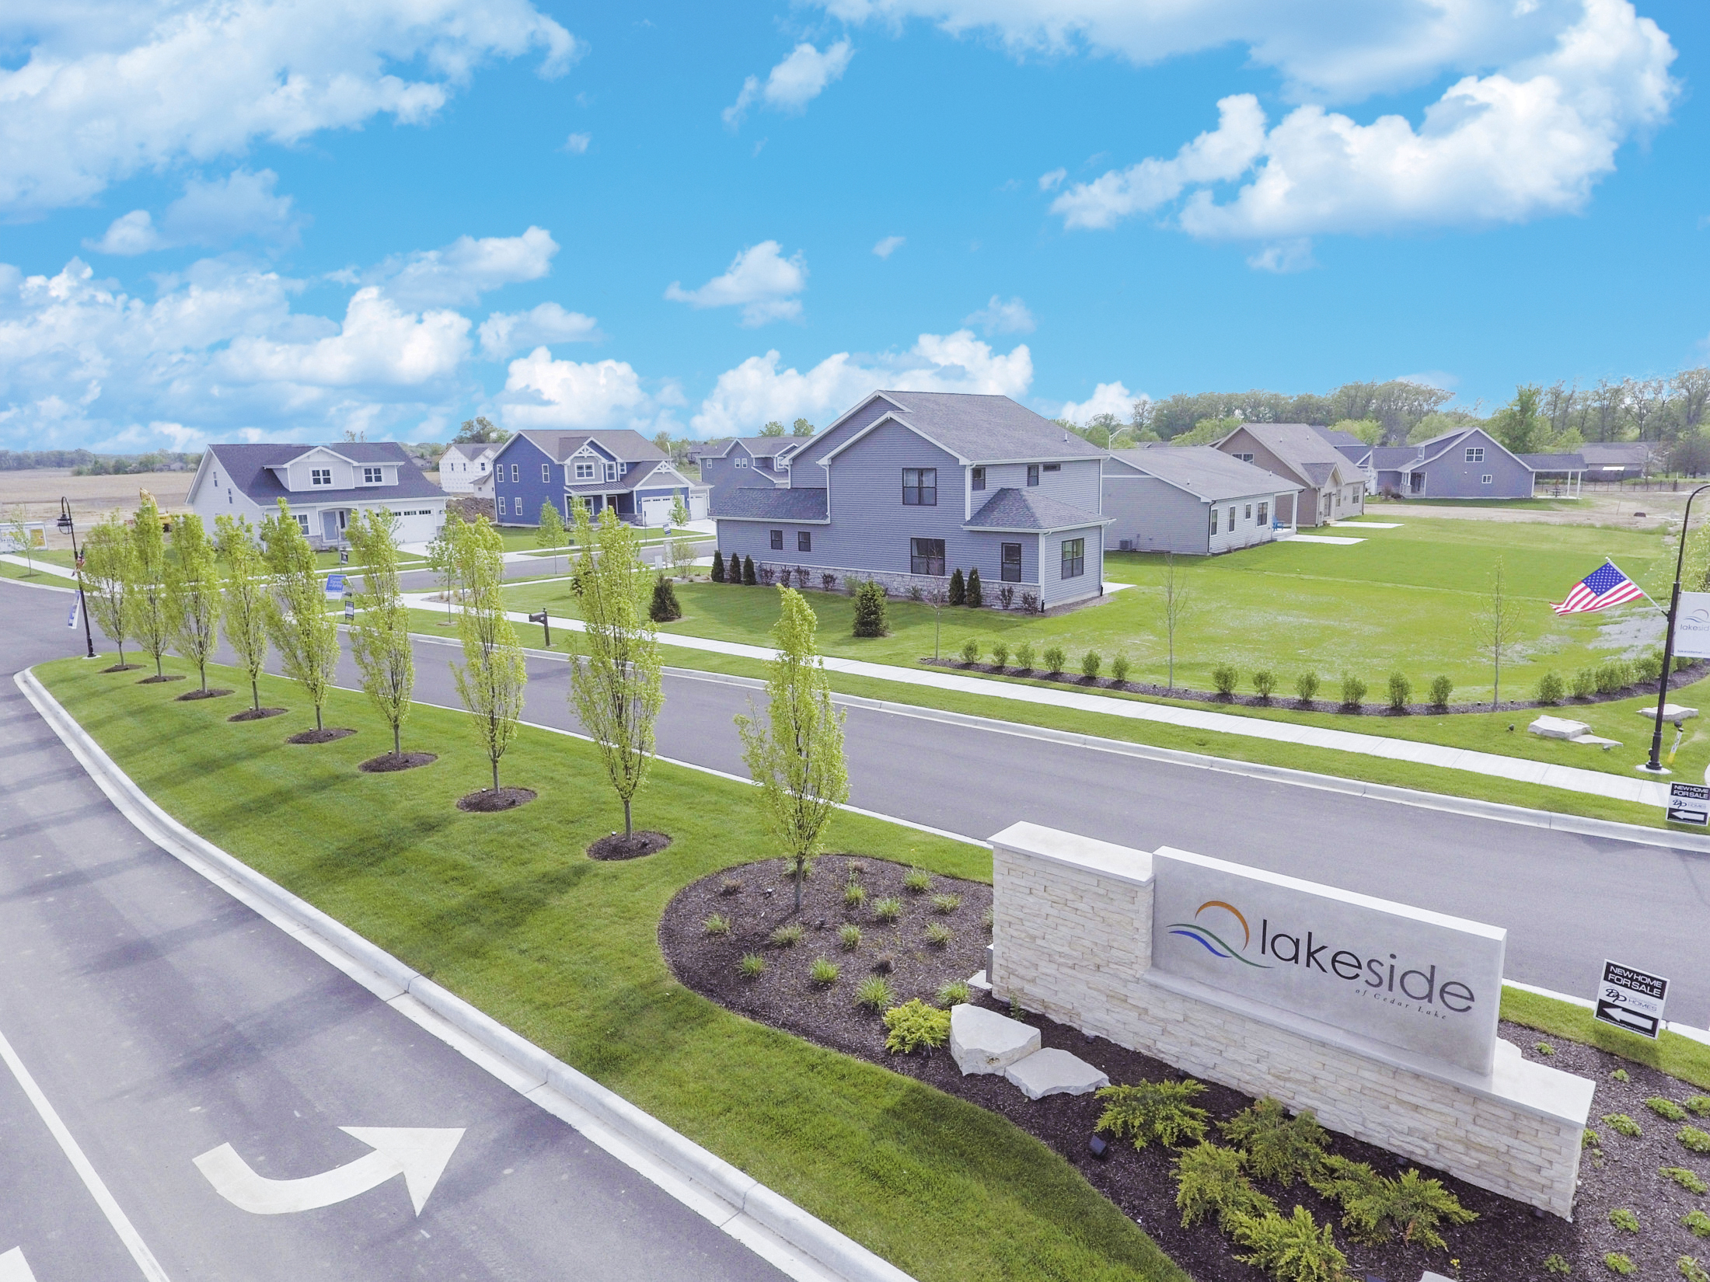

p2022 Public Hearing
Town of Cedar Lake
Qualified for Three-Year Growth Appeal - $71,181
  20 years compounded provides over $2M in total additional revenue
THREE-YEAR GROWTH APPEAL - CALCULATIONS
 |  | Town |  | Adjustments |  |  |  |  |  | Adjusted Town
Year |  | Assessed Value |  | 2007 Inventory |  | 2009 Homestead |  | Annexation |  | Assessed Value |  | Increase
2021 |  | $ 663,205,480 |  | $ 208,288 |  | $ 126,142,873 |  | $ - |  | $ 789,556,641 |  | 1.0874 | 8.74%
2020 |  | 600,232,689 |  | 208,288 |  | 126,142,873 |  | (517,800) |  | 726,066,050 |  | 1.0643 | 6.43%
2019 |  | 556,389,622 |  | 208,288 |  | 126,142,873 |  | (201,600) |  | 682,222,983 |  | 1.0535 | 5.35%
2018 |  | 521,450,089 |  | 208,288 |  | 126,142,873 |  | - |  | 647,599,650
 |  |  |  |  |  | Town three-year average growth |  |  |  |  |  | 1.0684 | 6.84%
As CNAV goes up
Property tax rates go down

Slide 5


p2022 Public Hearing
Town of Cedar Lake
  With growth comes increased needs

Slide 6
p2022 Public Hearing
Town of Cedar Lake
APPROPRIATIONS – General Fund
  Increased salaries and wages for Police and Fire Officers
    2021 Budget allowed for competitive and increased pay
    2022 Budget will allow for full staffing and 3% cost-of-living adjustment
    Police personal services budget increase of approximately $100,000
      Currently 22 full-time officers
      2022 Budget provides for 23 full-time officers plus a part-time code enforcement officer
    Fire personal services budget increase of approximately $185,000
      Currently 12 full-time fire fighters
      2022 Budget provides for 14 full-time officers – allows for 2 ambulances to run at all times
      Must obtain revenue source through fire service fees prior to hiring of second additional fire fighter
    Potential SAFER Grants for additional public safety officers

Slide 7

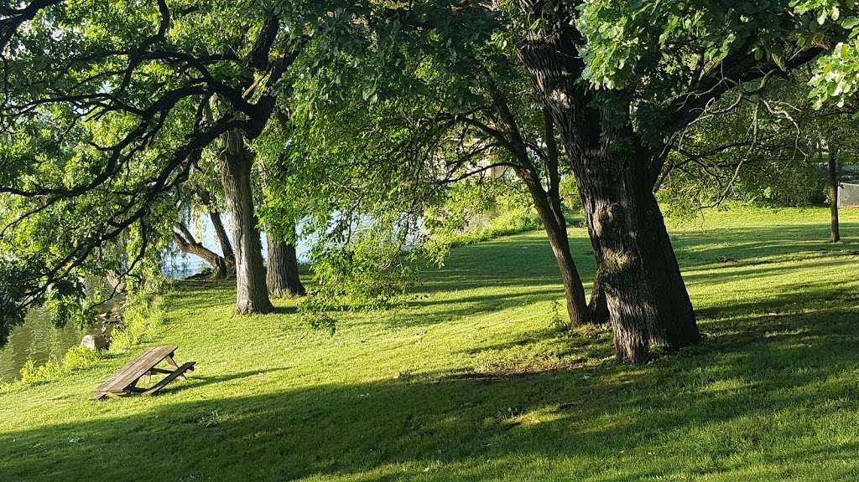
p2022 Public Hearing
Town of Cedar Lake
  APPROPRIATIONS – General Fund
    Town Administration Salaries and Wages
      Key position pay raises to more align with wages identified in AIM salary survey for similarly sized and located communities
        Clerk-Treasurer Department
          Staff pay increases of approximately 15% for CT and deputies; 10% for other staff clerks; elimination of part-time position to reduce budget impacts
        Planning, Zoning and Building Department
          Building Administrator, Building Coordinator and Building Inspector pay increases of approximately 9%
        Other Salaries and Wages Updates
          Part-time Parks and Recreation Coordinator
          Budgeting for Park Board
          Full-time custodian

Slide 8
p2022 Public Hearing
Town of Cedar Lake
APPROPRIATIONS – General Fund
  Overall increase of approximately $570,000 or 10.8%
    Offset from increases in revenues
      Increased Tax Levy of approximately $190,000
        Public Safety Officers
      Increased EMS and Fire Protection Charges of approximately $150,000
        Public Safety Officers
      Increased Planning, Zoning and Building Permits and Fees $300,000
        Key Position Raises
        Park Re-establishment
        Capital costs related to Planning, Zoning and Building functions
        Professional services related to growth/new projects

Slide 9
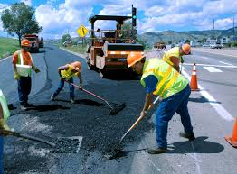
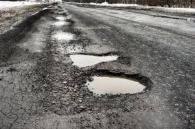
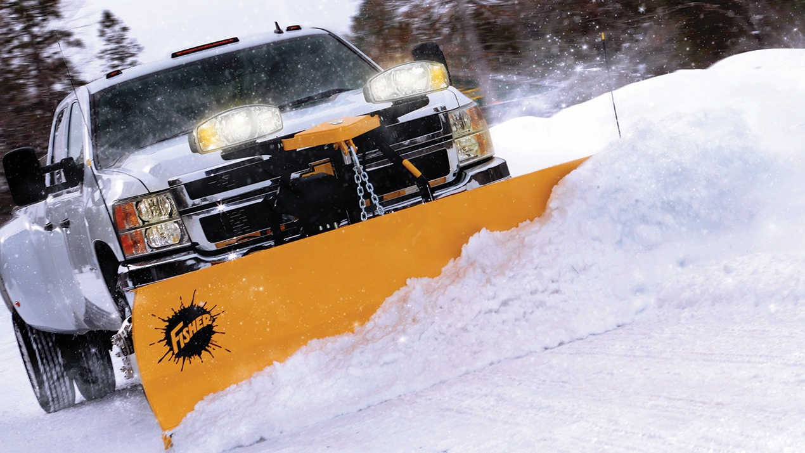
p2022 Public Hearing
Town of Cedar Lake
APPROPRIATIONS – MVH and LRS
  Public Works Salaries and Wages
    Salary and wage increases for leadership positions
      Increases vary from 5% to 11% based on position
    Salary and wage COL adjustments of 3% for other public works employees
  MVH budget increased by approximately $23,000 or 4.5%
    Increased personal services of $9,000 and increased supplies need of $11,750
    MVH Restricted - $227,440 allocated to preservation, construction and re-construction for 2022
  LRS budget increased by $55,000
    Additional $20,000 allocated for salt needs, reductions in other supplies
    $50,000 in contracted maintenance appropriations for plowing/mowing

Slide 10
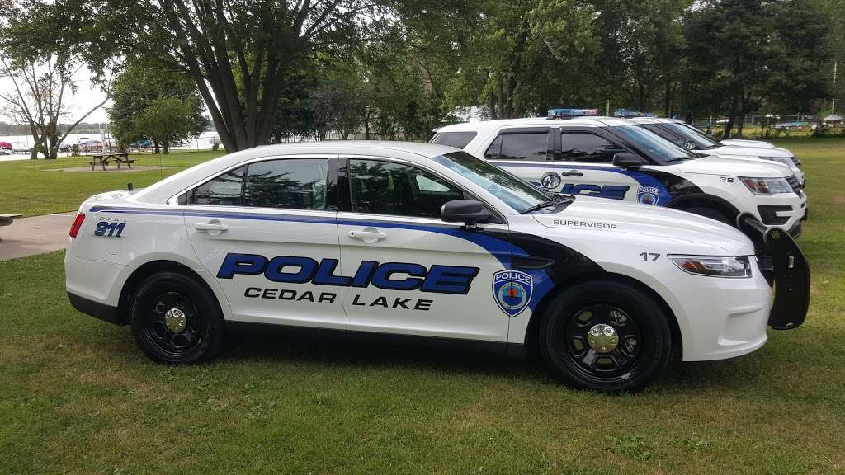
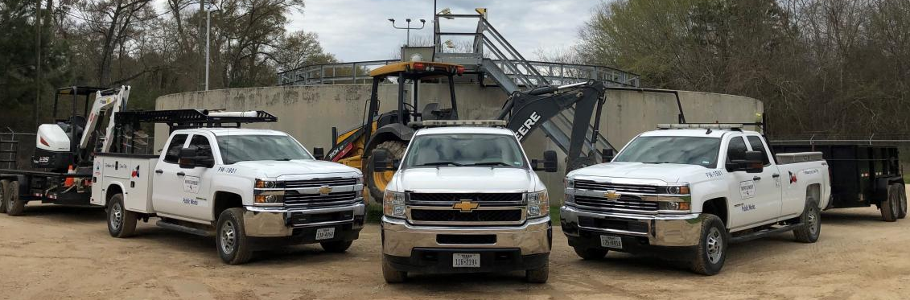

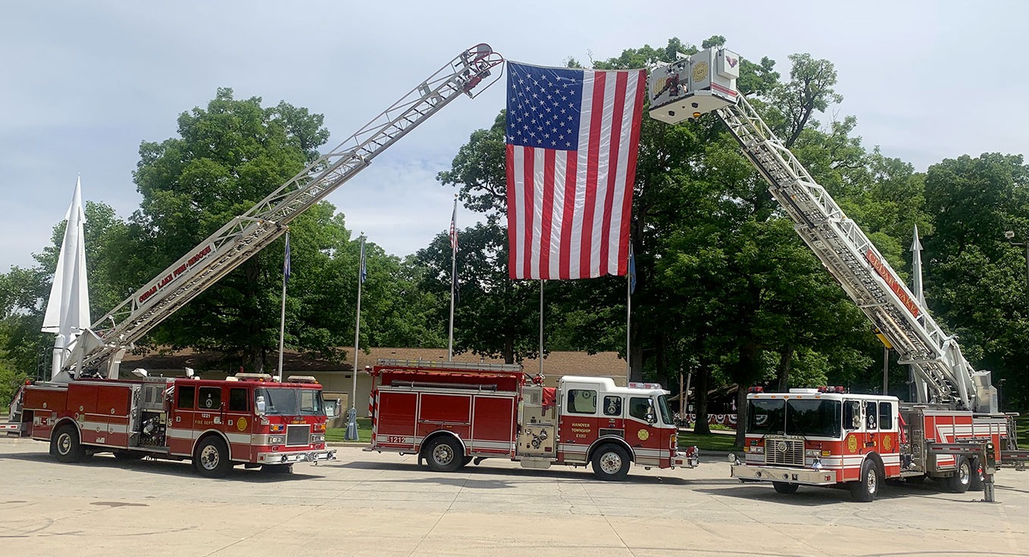
p2022 Public Hearing
Town of Cedar Lake
APPROPRIATIONS – Cumulative Funds
  CCD budget increased by approximately $35,000 or 9%
    “Capital equipment replacement” fund
    2019 fire truck lease
    2019 police squads
    2022 police squads
    Ambulance and equipment lease
    Remaining balance for capital allowance
      $85,000 for police equipment
      $35,000 for fire equipment
      $54,000 for public works
      $10,000 for technology improvements
  CCI budget has no major changes
    IT, software and computer equipment are budgeted

Slide 11
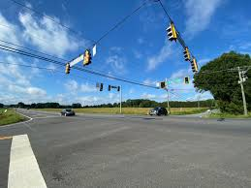
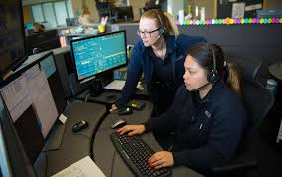
p2022 Public Hearing
Town of Cedar Lake
APPROPRIATIONS – Local Income Tax Funds
  CEDIT (LIT – Economic Development)
    2015 Road Bond
    $90,000 budgeted for professional services for economic development projects
    $302,000 total budgeted for Special Projects
  LOIT Public Safety (LIT – Public Safety)
    Pays major portion of PSAP contract - $250,000 budgeted for 2022
    Total PSAP cost estimate is $400,000 ($150,000 is payable from General Fund)

Slide 12
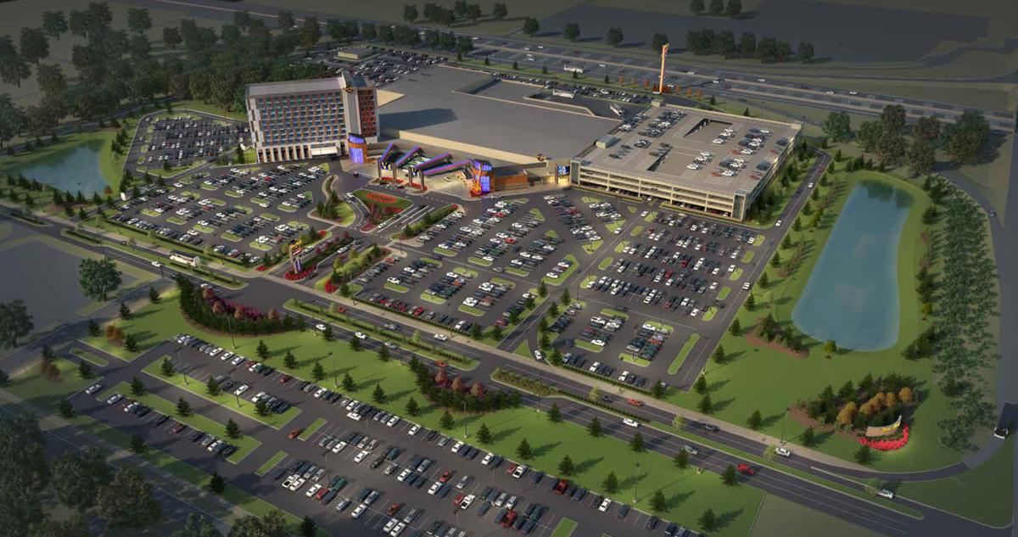
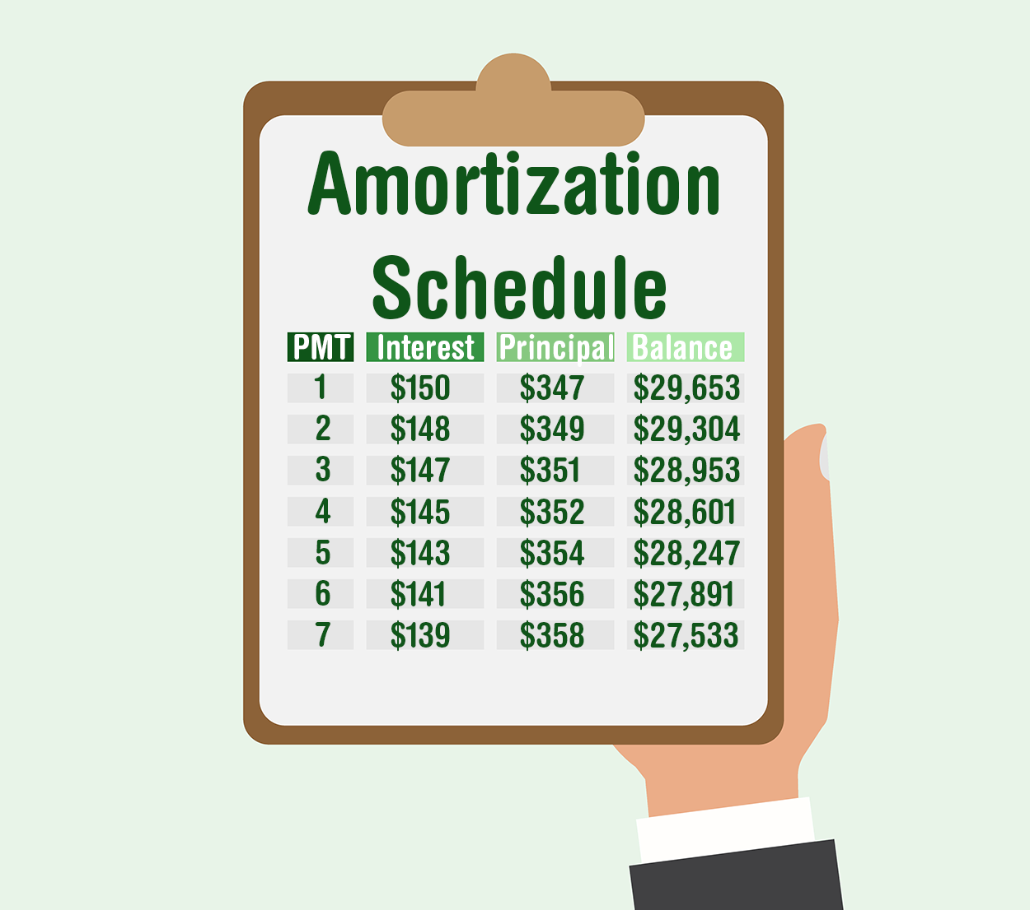
p2022 Public Hearing
Town of Cedar Lake
APPROPRIATIONS – Other Funds
  Casino Gaming Fund
    $227,000 identified for Highland Subdivision road improvements
    Only funds of $206,192 are available based on current estimates
      All funds have been budgeted
  Debt Service Funds
    Debt service funds are budgeted based on their
    amortization schedules and payments due
  Redevelopment General
    No major changes

Slide 13
p2022 Public Hearing
Town of Cedar Lake
APPROPRIATIONS – Other Funds
  Casino Gaming Fund
    $227,000 identified for Highland Subdivision road improvements
    Only funds of $206,192 are available based on current estimates
      All funds have been budgeted
  Debt Service Funds
    Debt service funds are budgeted based on their
    amortization schedules and payments due
  Redevelopment General
    No major changes

Slide 14
p2022 Public Hearing
Town of Cedar Lake
HISTORICAL CERTIFIED NET ASSESSED VALUE AND TOTAL TOWN TAX RATE
 |  | 2017 |  | 2018 |  | 2019 |  | 2020 |  | 2021 |  | 2022 Est.*
Certified Net Assessed Value |  | $ 491,469,612 |  | $ 521,450,089 |  | $ 556,389,622 |  | $ 600,232,689 |  | $ 663,205,480 |  | $ 709,629,864
Town Tax Rate |  | $ 0.8083 |  | $ 0.7024 |  | $ 0.6401 |  | $ 0.6657 |  | $ 0.5772 |  | $ 0.6163
* Assumes a 7% increase in CNAV over 2021 amounts.
Questions, comments or discussion?

